Slide 1
CPR Provider Program for Utilities
The Institute for Safety in Powerline Construction
© Copyright by the Institute for Safety in Powerline Construction 3504 Parliament Ct. Alexandria, LA 71303 All rights reserved. This material or any part thereof may not be reproduced in any form without the written permission of the Institute for Safety in Powerline Construction

Slide 2
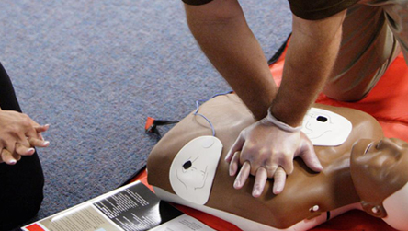
CPR
Cardio-Pulmonary Resuscitation

Slide 3
Knowledge Objectives
To understand when to activate Emergency Medical Services (EMS)
To understand a basic knowledge of the heart and respiratory system
To understand the ABCs of assessment on adult and pediatric patients
To understand the signs and symptoms of a possible heart attack
To be aware of the risk factors of heart attack
Notes:
Cardiopulmonary resuscitation (CPR) is a proven rescue technique used when someone’s breathing or heartbeat has stopped.
It is a combination of rescue techniques that were developed in the late 1950s to the early 1960s.

Slide 4
Skill Objectives
To be able to adequately perform cardiac compressions and ventilations on an adult, child & infant patients in need
To be able to perform the procedures for a Foreign Body Airway Obstruction (FBAO) on either a conscious and unconscious patient
To be able to apply your newfound skills to real-life situations in the field
Notes:
CPR is the use of chest compressions and mouth-to-mouth breathing that allows some oxygenated blood to flow to the brain and other organs.
Ultimately it buys the victim time until advanced medical support can arrive.

Slide 5
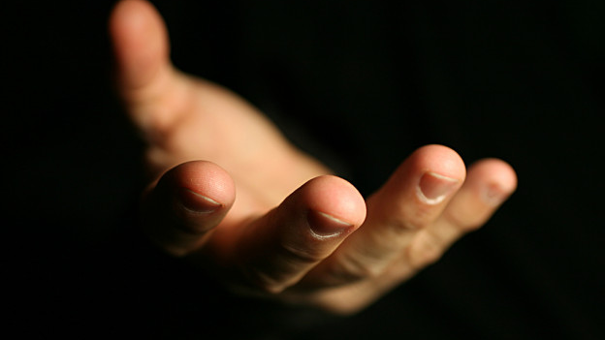
Good Samaritan Law
Any person, who in good faith, without compensation* administers CPR, cannot be held liable for acts of omission or commission. *not to be construed as the salaries of police, fire, or EMS personnel
Hopefully, minimizes the fear of possible legal consequences when performing CPR to the best of the provider’s ability
Notes:
It is good to know that all 50 states have a “Good Samaritan” law that protects the first aid provider.
Deciding to help is a big decision.
CPR is designed to cause no further harm and without your involvement the victim will surely die.
Lend assistance even if others are already involved.

Slide 6
Why Should I Learn CPR?
To be capable of handling a cardiac emergency
To be able to recognize the signs & symptoms of a heart attack
To assist in the reduction of cardiac death through education
Notes:
After deciding to help, the rescuer must take the time to do an assessment of the immediate area. This allows time to gather information and to look for potential hazards.
Many “would-be” rescuers have accidentally become victims themselves due to an incomplete assessment of the accident scene.
In a situation involving electrical shock, make sure that the lines have been de-energized before approaching the patient.
Look for any hazards such as traffic, chemical or gas exposure, downed wires or environmental hazards.

Slide 7
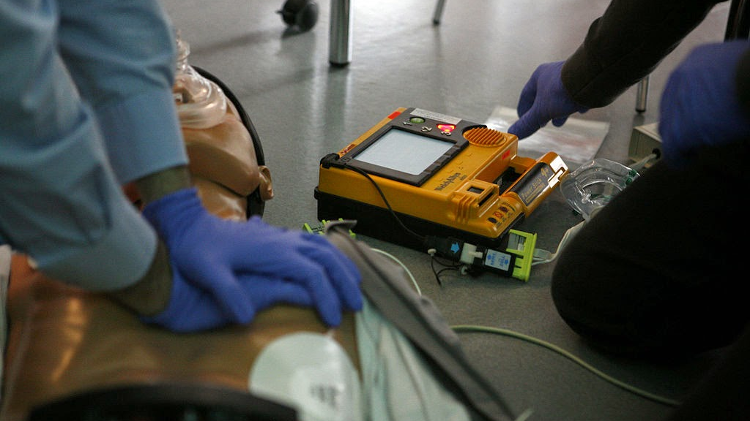
SETUP

Slide 8
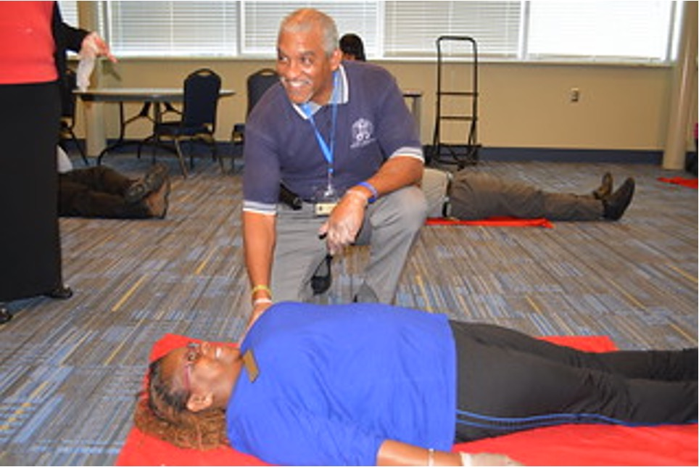
SETUP
Stop
Take a breath
Think primary assessment
Think mechanism of injury
Notes:
Many “would-be” rescuers have accidentally become victims themselves due to an incomplete assessment of the accident scene

Slide 9
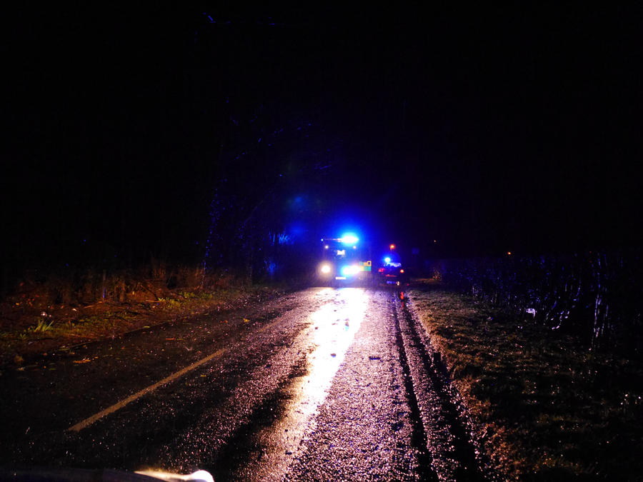
SETUP
Environment
Consider limitations
Notes:
Many “would-be” rescuers have accidentally become victims themselves due to an incomplete assessment of the accident scene.

Slide 10
SETUP
Traffic
Vehicles positions
Safe approach
Remain alert
Notes:
Remain aware of the surroundings and don’t become another victim

Slide 11
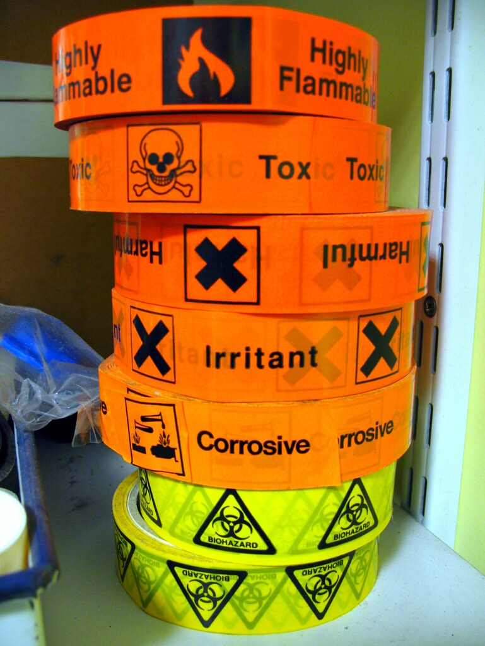
SETUP
Unknown Hazard
Gas
Chemical
Electrical
Fire
Collapse
Lack of oxygen
Weapons
Notes:
Those things that surprise you
“I didn’t see that!”

Slide 12
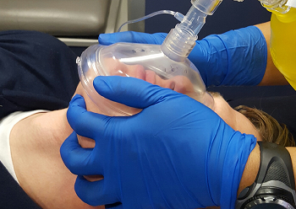
SETUP
Protect Self and Patient
Prevent further harm
Use barriers
Notes:
Remember to protect yourself from the transfer of bodily fluids by using gloves and breathing barriers

Slide 13
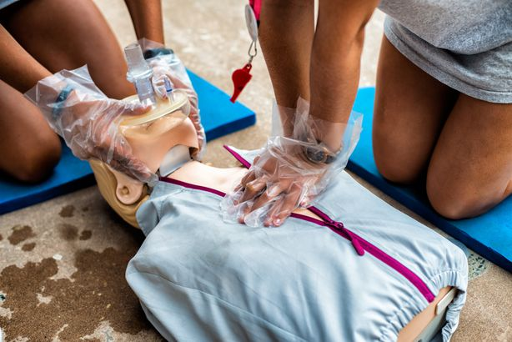
Bloodborne Pathogens 29 CFR 1910.1030
Barrier Protection
Risk of communicable disease
Lay rescuers often know the victim
Perform chest compressions, at least
Notes:
Even if you KNOW the victim, the rescue may become ugly

Slide 14
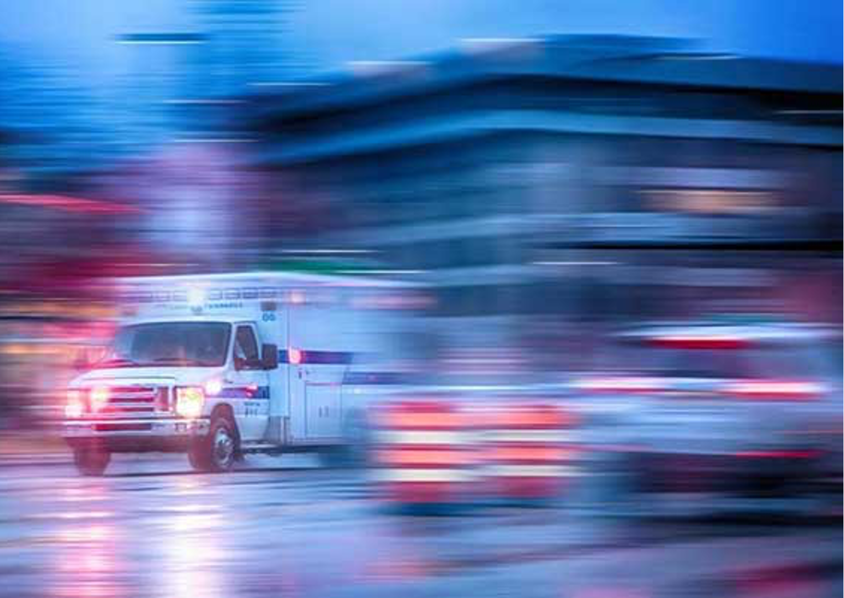
Chain of Survival
Four Links in the Chain of Survival
Early Access
Early CPR
Early Defibrillation
Early Advanced Care
Notes:
Activate EMS as soon as possible

Slide 15
Chain of Survival
Early Access
Early identification of patient collapse
Recognition of unresponsiveness
Rapid activation of EMS
Rapid arrival of EMS responders
Identification of the arrested state
Notes:
Have basic information ready such as location and initial observations

Slide 16
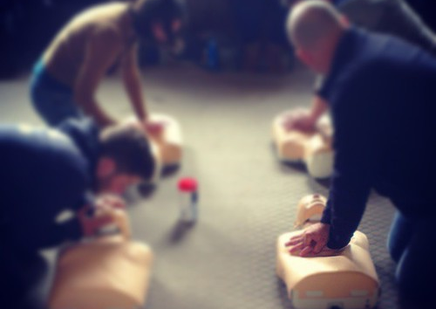
Chain of Survival
Early CPR
Most beneficial when started early
Bystander CPR has positive effect on patient outcome
Community-wide CPR programs (schools)
Most beneficial when the next links follow rapidly
Notes:
If possible, stay on the phone. Some operators may be trained to help guide you through the emergency

Slide 17
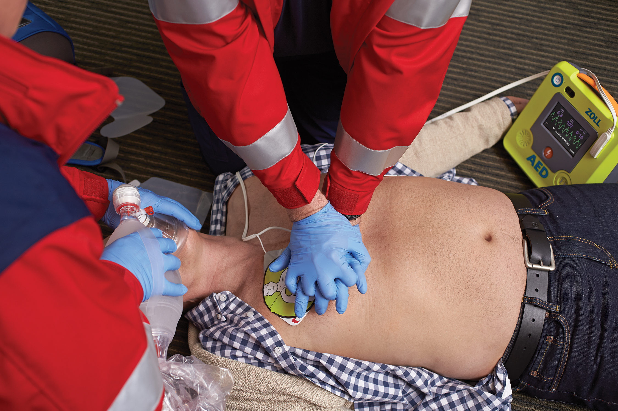
Chain of Survival
Early Defibrillation
Most vital link
Most likely to improve survival rates
Jump start the heart
Defibrillation is why we must activate EMS early
Notes:
Learn how the defibrillator works

Slide 18
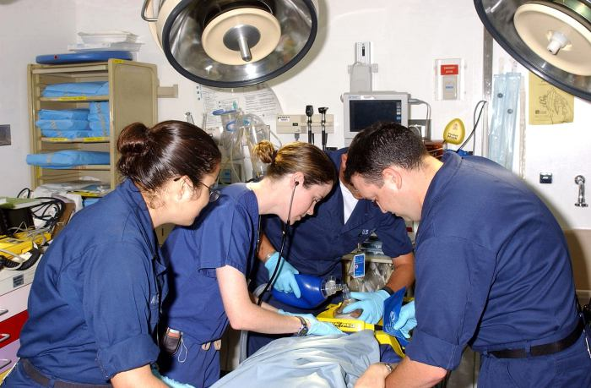
Chain of Survival
Early Advanced Cardiac Life Support (ACLS)
Provided by cardiac technicians and paramedics
Includes:
Advanced airway support
IV and drug administration
Controls heart arrhythmias

Slide 19
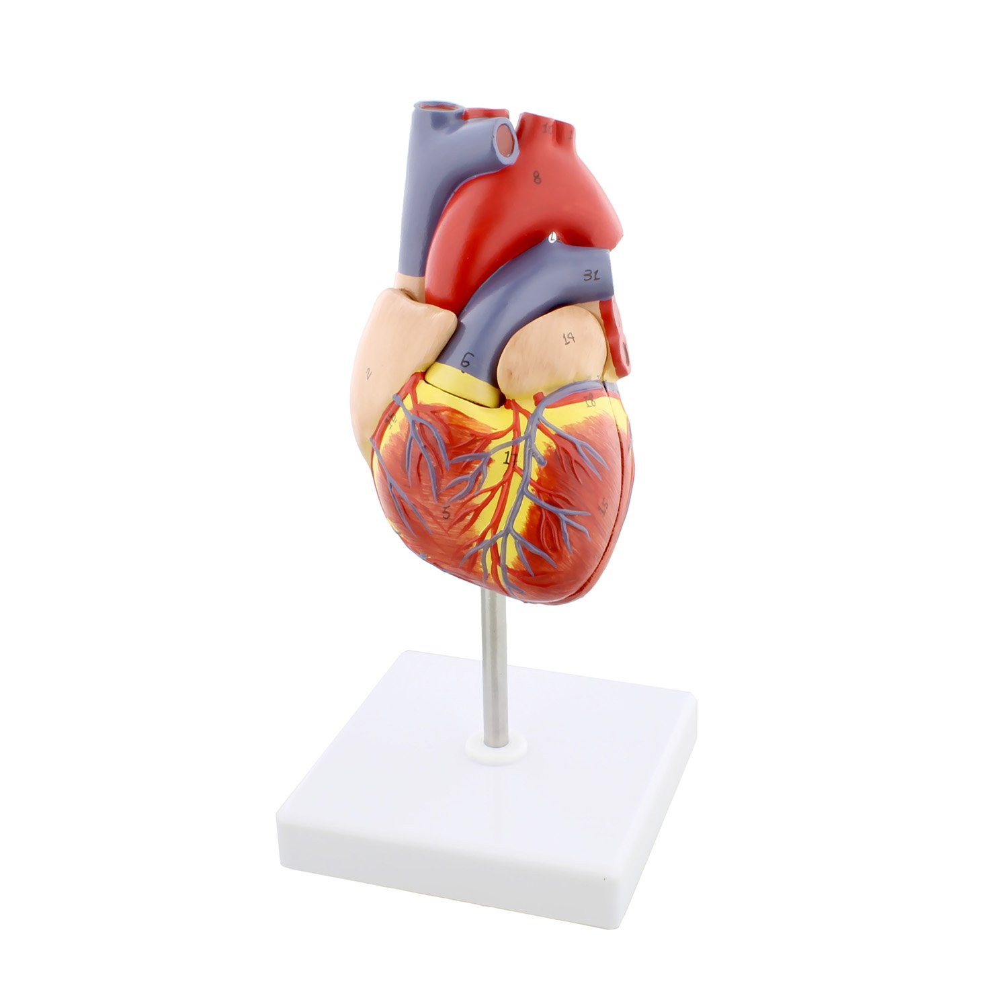
Heart Anatomy
Specialized muscle
Size and position
The pump

Slide 20
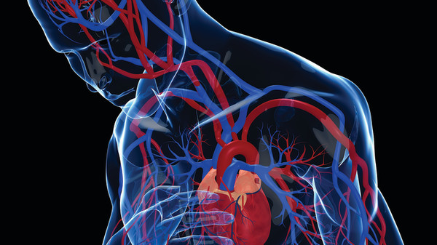
Heart Anatomy
The heart is positioned between the breastbone (sternum) and the spine
Cardiac compression should be adequate enough to eject blood from the chambers

Slide 21
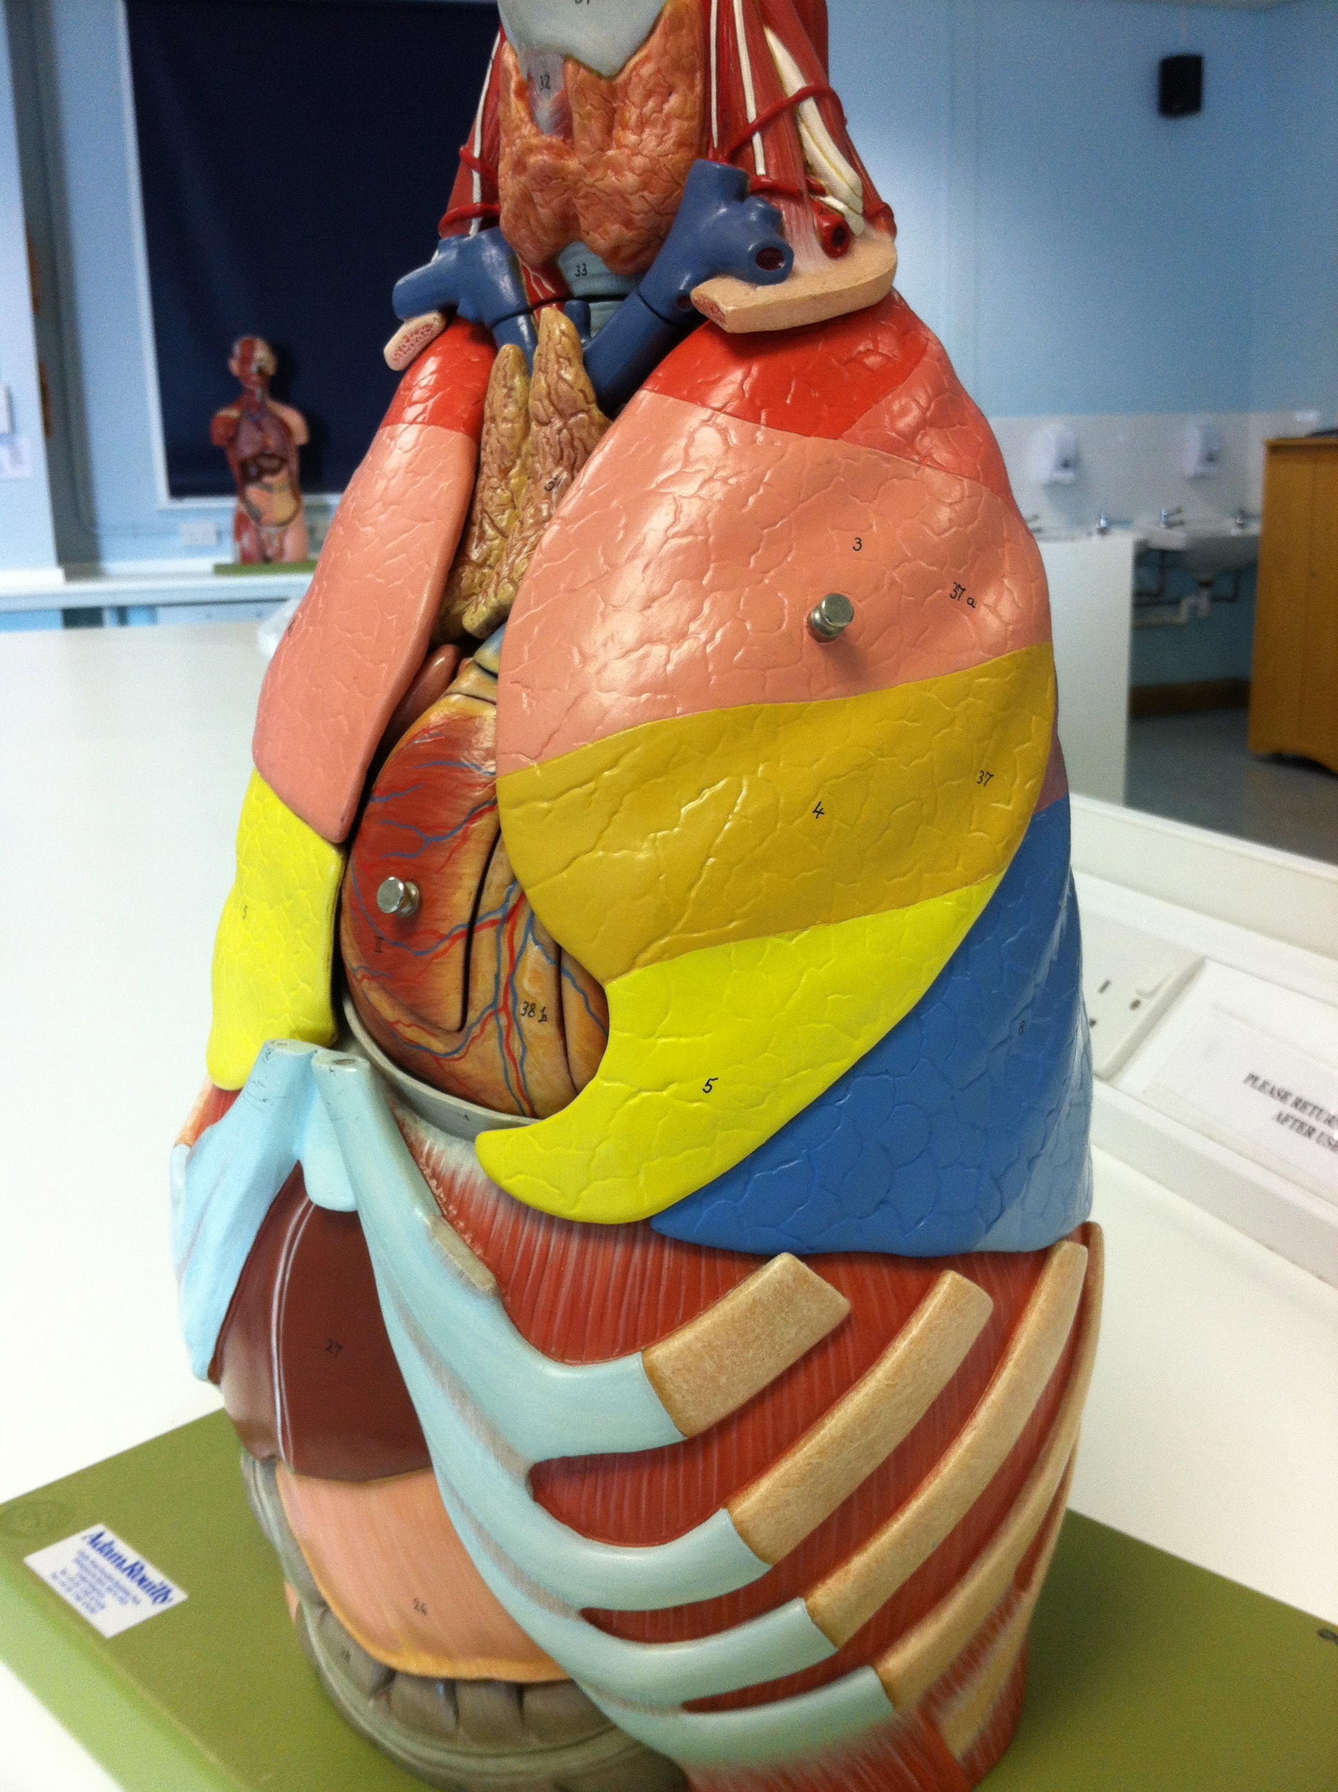
Lung Anatomy
Air sacs’ grape-like clusters exchange oxygen
Lungs are like sponges (solid, not hollow)
If air goes in and out, and oxygen goes round and round, then everything is good!
Notes:
Some CPR entities do not require breaths for a non-responsive heart, only compressions

Slide 22
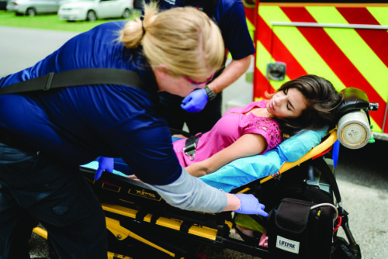
Respiratory Arrest
The tongue is the most common anatomical airway obstruction
Other causes:
Drug overdose
Narcotics
Barbiturates
Head trauma
Notes:
The victim may have choked, and the object is still lodged

Slide 23
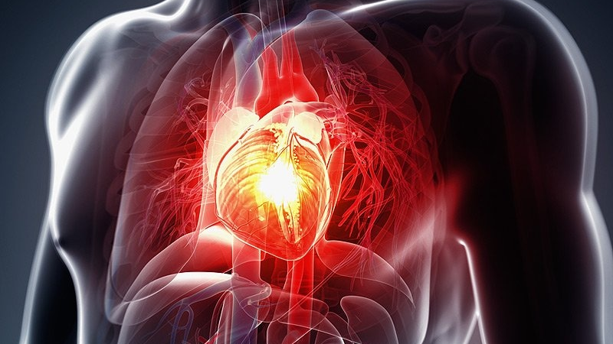
Coronary Artery Disease (CAD)
Diseases of the heart
Hardening of the arteries – Arteriosclerosis
Formation of fatty deposits – Atherosclerosis: Coronary Artery Disease (CAD)
Notes:
We don’t all take very good care of ourselves

Slide 24
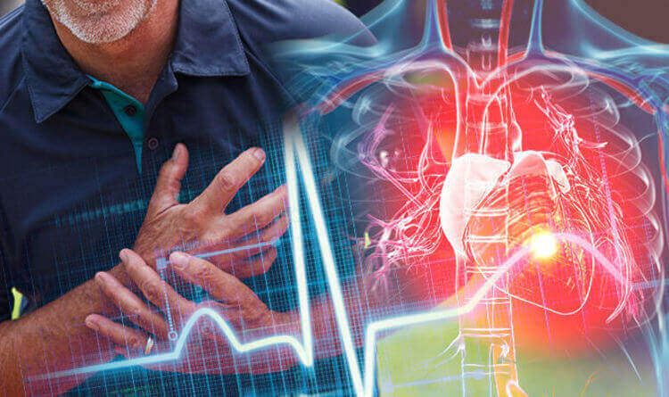
Coronary Heart Disease (CHD)
Symptomatic – with symptoms
Asymptomatic – without symptoms

Slide 25
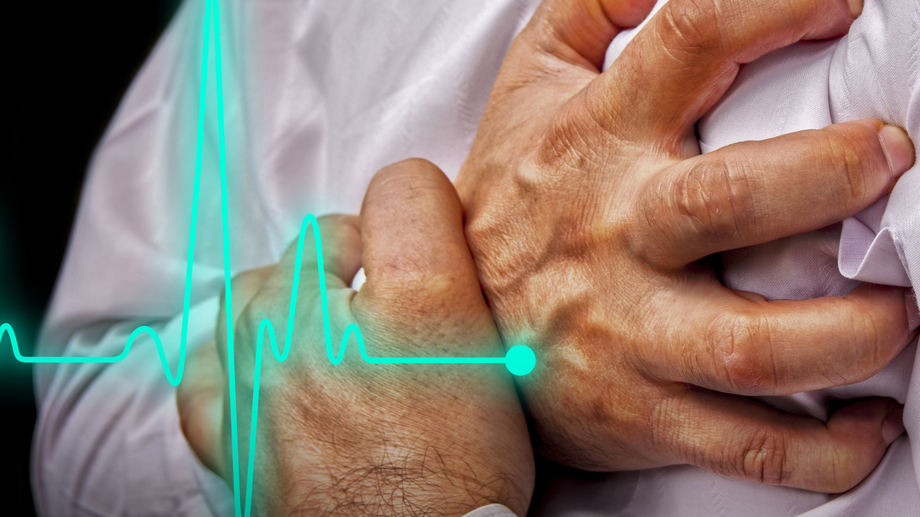
Coronary Heart Disease (CHD)
Angina Pectoris – common symptom of CHD
Pain or discomfort due to a temporary lack of blood supply to the heart
Pain or discomfort (chest, neck, arm, jaw, teeth)
Lasts two to 15 minutes, and is relieved by rest or nitroglycerin

Slide 26
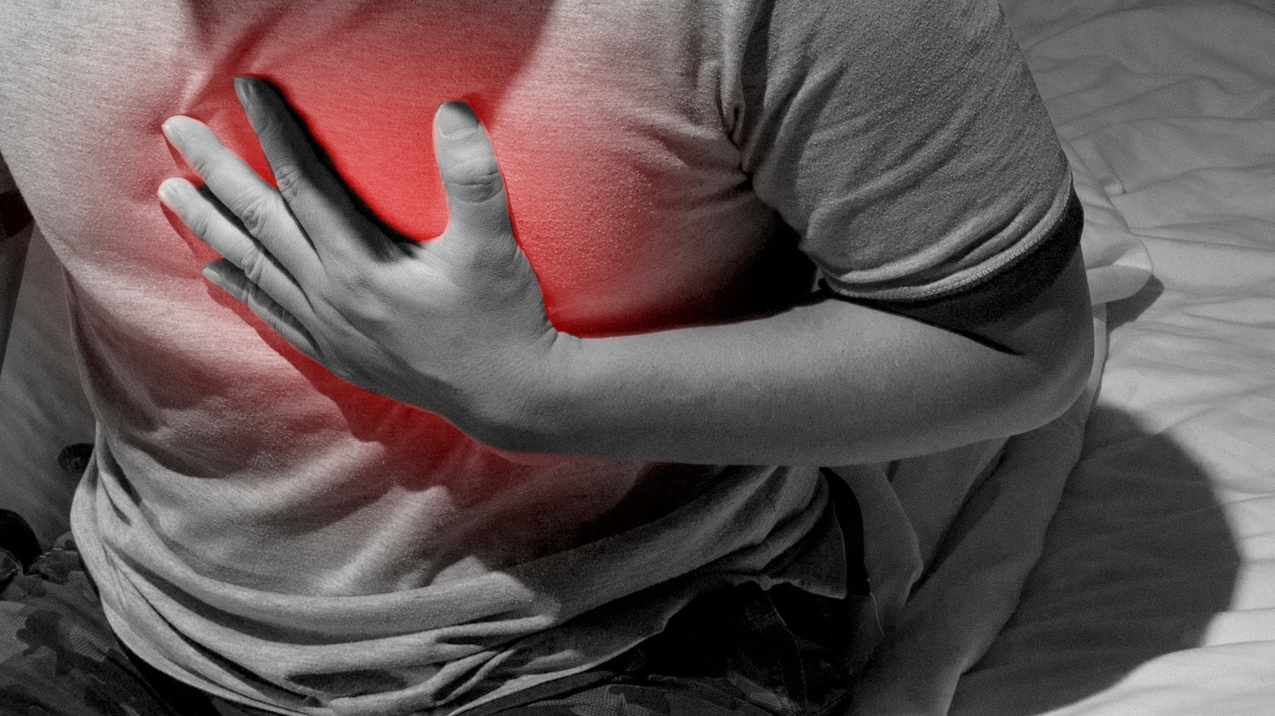
Coronary Heart Disease (CHD)
Acute Myocardial Infarction (AMI)
Lack of adequate blood flow causing death of the heart muscle
Pain or discomfort (chest, neck, arms, jaw, teeth)
Lasts longer than 15 to 20 minutes, and is not relieved by rest or nitroglycerin

Slide 27
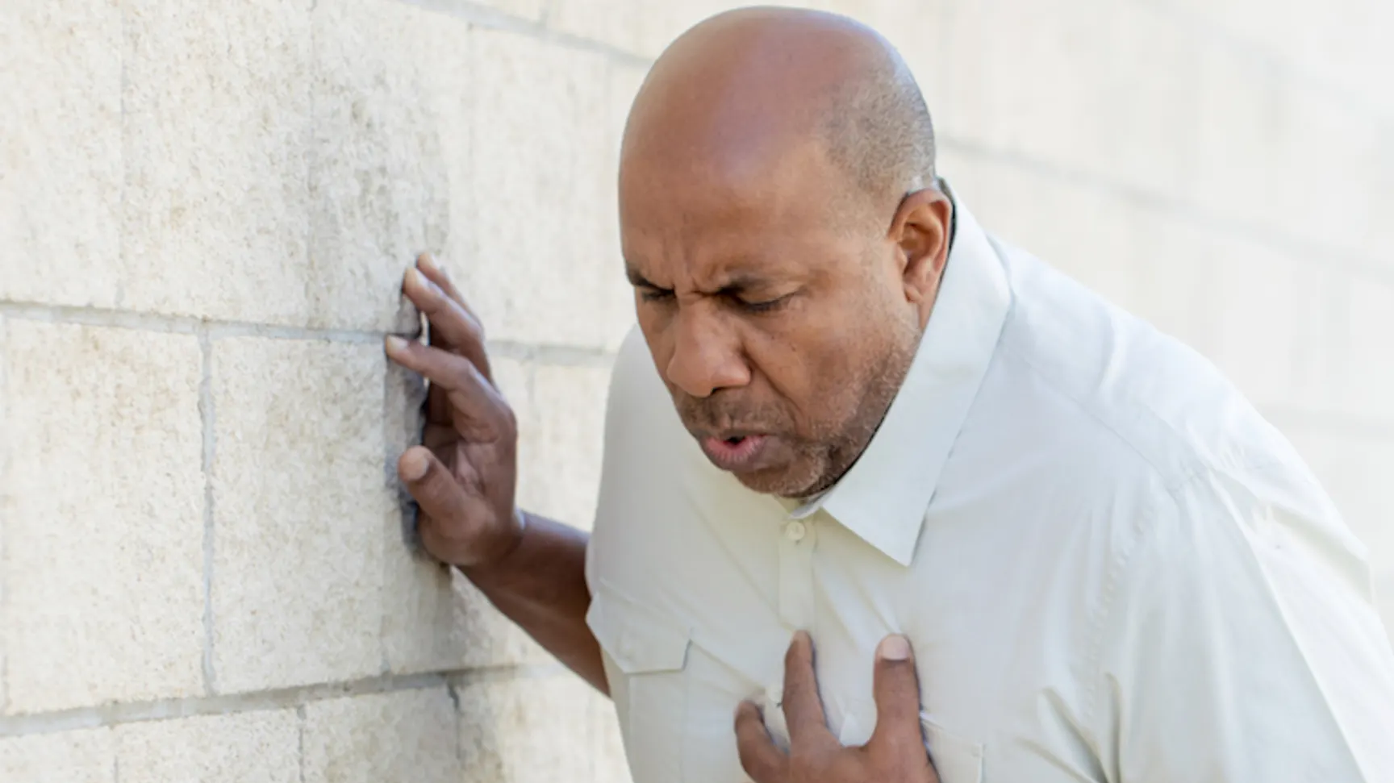
Coronary Heart Disease (CHD)
Warning Signs
“The elephant has come to visit”
Sweating, nausea, or shortness of breath
Remember: 20% of all heart attacks may have no pain (“silent killer”)

Slide 28
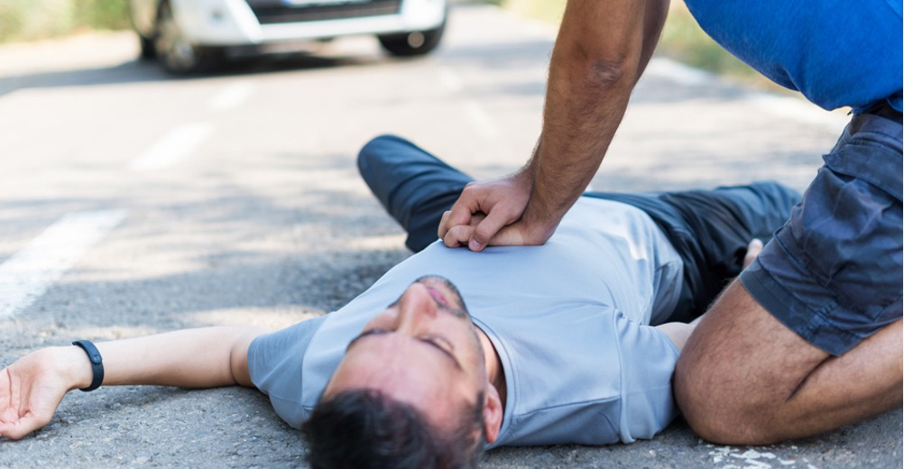
Coronary Heart Disease (CHD)
Over 50% of deaths occur before the victim reaches the hospital – most within two hours of the onset of symptoms
Most victims wait three hours before seeking any assistance
Self-denial can kill

Slide 29
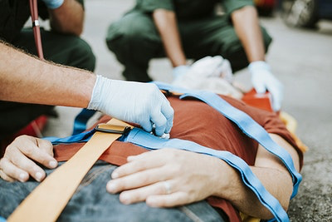
CPR Techniques
National success rate for out of hospital cardiac arrest to hospital discharge is 15%

Slide 30
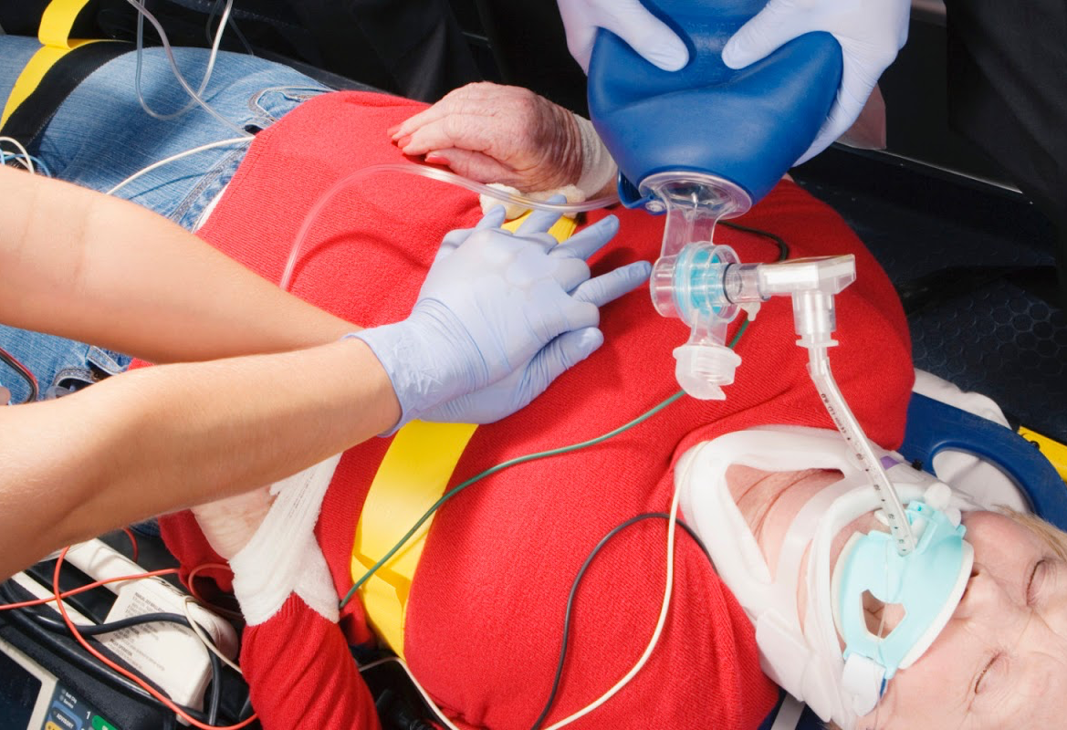
Sudden Cardiac Death (Cardiac Arrest)
Heartbeat and breathing stop abruptly or unexpectedly
May be the only manifestation of CHD
Occurs most often 1 to 2 hours after the beginning of a heart attack
Other causes:
Severe Allergic Reaction
Electrocution
Lightning Strike

Slide 31
Risk Factors for Heart Attack
Factors that CAN be Changed
Factors that CANNOT be Changed
Heredity
Gender
Age
Smoking
High Blood Pressure
Cholesterol
Physical Activities

Slide 32
Risk Factors for Heart Attack
Contributing Factors
Prudent Heart Living
Diabetes
Obesity
Excessive Stress
Combined risk factors increase chances of a heart attack
Quit smoking
Control high blood pressure
Lower cholesterol
Exercise more
Control diabetes
Lose weight

Slide 33
Airway Obstruction
Foreign Body Airway Obstruction (FBAO)
Confirm Airway Obstruction
Perform Heimlich maneuver first
Perform chest thrusts first for advanced
Pregnancy or severe obesity
Notes:
Check the unresponsive patient for breathing. This should last no longer than 10 seconds.
Look for chest motion, listen for breathing and feel for breath on your cheek.

Slide 34
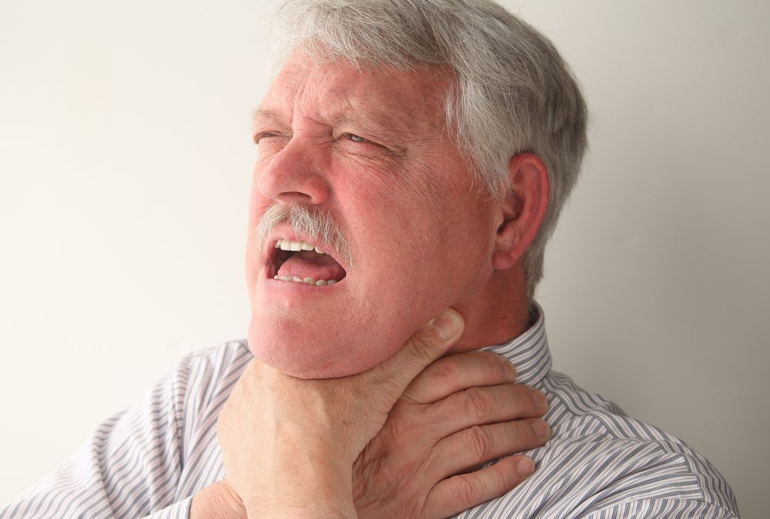
Foreign Body Airway Obstruction (FBAO)
Causes
Tongue (most common anatomical obstruction)
Dentures
Excessive alcohol consumption
Notes:
Image shows universal distress signal
If the victim is not breathing, try to establish an open airway using the head tilt-chin lift method.
Remove all solid matter from the mouth using a finger sweep with a gloved hand.
If the mouth has liquid in it, then roll victim on their side using a “log roll” maneuver to allow the fluid to drain.

Slide 35
Response to Cardio-Pulmonary Emergencies
Call 911 first
Activate the EMS system
ABCs
Airway
Breathing
Circulation
Notes:
Remembering the ABCs is vital for proper assessment of the injured person’s condition
Proper administration of the ABCs, coupled with ongoing assessment, is critical to victim’s survival

Slide 36
ABCs
Airway
Open by manual methods
Head-tilt/Chin-lift
Modified jaw thrust (trauma)
Patent
Notes:
Place rescue breathing mask or shield, flat on the patient’s face, pinching the nostrils if required
Use the head tilt / chin lift method to establish the airway
Make sure to create an airtight seal around the patient’s mouth

Slide 37
ABCs
Breathing
Look, Listen, Feel
Mouth-to-mouth (use barrier or mask)
If not breathing, give two rescue breaths
If no air movement through nose or mouth, patient is in respiratory arrest
Slower ventilations
Lung compliance decreases during CPR
High pressure ventilation fills stomach with air
Must ventilate slowly with low pressure

Slide 38
ABCs
Circulation
Pulse check (carotid artery in neck)
No more than 5-10 seconds
If no pulse, begin chest compressions
Proper hand position
Proper compression techniques
Still only 33% effective, even if done 100% properly
Recheck pulse after one minute of CPR, and every few minutes after
Notes:
The brain tissue begins dying in as little as 4 minutes and is generally fatal after 10
Proper technique can greatly increase the flow of blood to the brain and other vital organs

Slide 39
Remember Your ABCs
Check responsiveness (may have fainted)
Activate EMS/Call 911
Open airway
Check breathing
Check circulation (pulse)

Slide 40
CPR Techniques
Time of CPR (mins) | Time of ACLS (mins) | Survival Rate
0-4 | 0-8 | 43%
0-4 | 16+ | 10%
8-12 | 8-16 | 6%
8-12 | 16+ | 0%
12+ | 12+ | 0%
Every minute without CPR decreases survival chances 10%

Slide 41
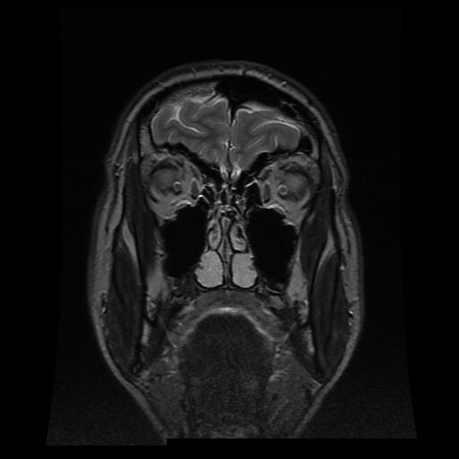
CPR Techniques
Brain damage can begin after 4 minutes
Brain damage is certain after 10 minutes

Slide 42
CPR Techniques
1-minute lapse = 90% chance of survivability
2-minute lapse = 80% chance of survivability
3-minute lapse = 70% chance of survivability
4-minute lapse = 60% chance of survivability
5-minute lapse = 50% chance of survivability
6-minute lapse = 40% chance of survivability
7-minute lapse = 30% chance of survivability
8-minute lapse = 20% chance of survivability
9-minute lapse = 10% chance of survivability
10-minute lapse = 0% chance of survivability

Slide 43
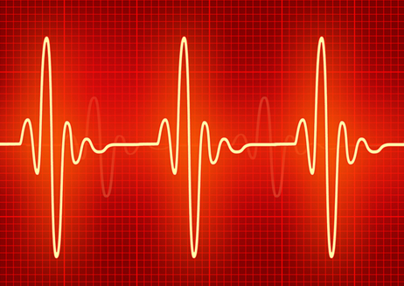
CPR Techniques
If the provider performs CPR 100% properly, it is still only 33% effective for the victim
Any pulse that the victim produces on their own is better than a pulse that is artificially generated

Slide 44
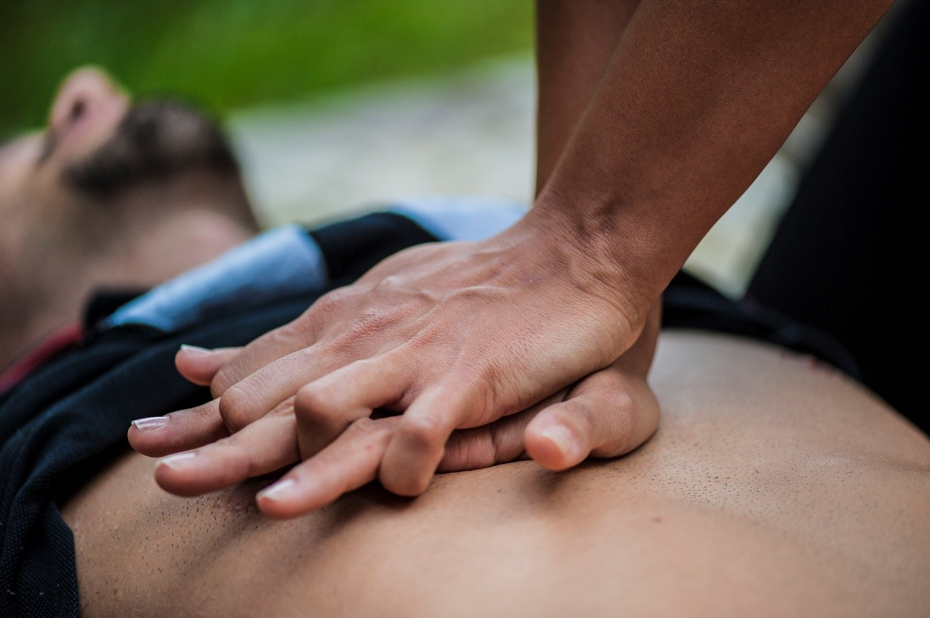
CPR Techniques
Place one hand on top of the other with the heel of the lower hand pressing over the lower half of the sternum to perform chest compressions on an adult.

Slide 45
CPR Techniques
Phone first
ABCs: Airway, Breathing, Circulation
Slow ventilations over 1.5 - 2 seconds
Barrier protection consideration
Recovery position
Chest compression optimized

Slide 46
CPR Techniques
For patients who are not breathing, give rescue breaths
If the patient has a pulse, they DO NOT need chest compressions
Recovery position
unresponsive victim with spontaneous respirations
roll victim on side, as unit
do not attempt if cervical spine(neck)injury is suspected

Slide 47
CPR Rules of Thumb
 | Adult | Child | Infant
Age | 8+ years | 1-8 years | 0-1 year
Hand Position | Heel of 2 hands | Heel of 1 hand | 2 fingers
Rate (compressions/min) | 80-100 | 100 | At least 100
Ratio | 15:2 | 5:1 | 5:1
Depth | 1.5-2 inches | 1-1.5 inches | .5-1 inches
Rescue Breathing
 | Adult | Child | Infant
Age | 8+ years | 1-8 years | 0-1 year
Rate (breaths/minute) | 12 | 20 | 20
Ratio | 1:5-6 | 1:3 | 1:3

Slide 48
CPR Techniques
Chest compressions
Rate: 80 to 100 per minute
Depth: 1.5 - 2 inches
Check pulses during compression
May need to compress deeper in some patients
Ratio: 15 compressions for 2 ventilations
Pause AFTER the last compression to allow for a breath of 1.5 - 2 seconds to be delivered

Slide 49
CPR Techniques
Patient must be moved to a firm surface (backboard, floor) prior to beginning compressions
Do not attempt CPR while the patient is located on the bed or sofa
Remember: Complications of CPR can be minimized, but not totally prevented

Slide 50
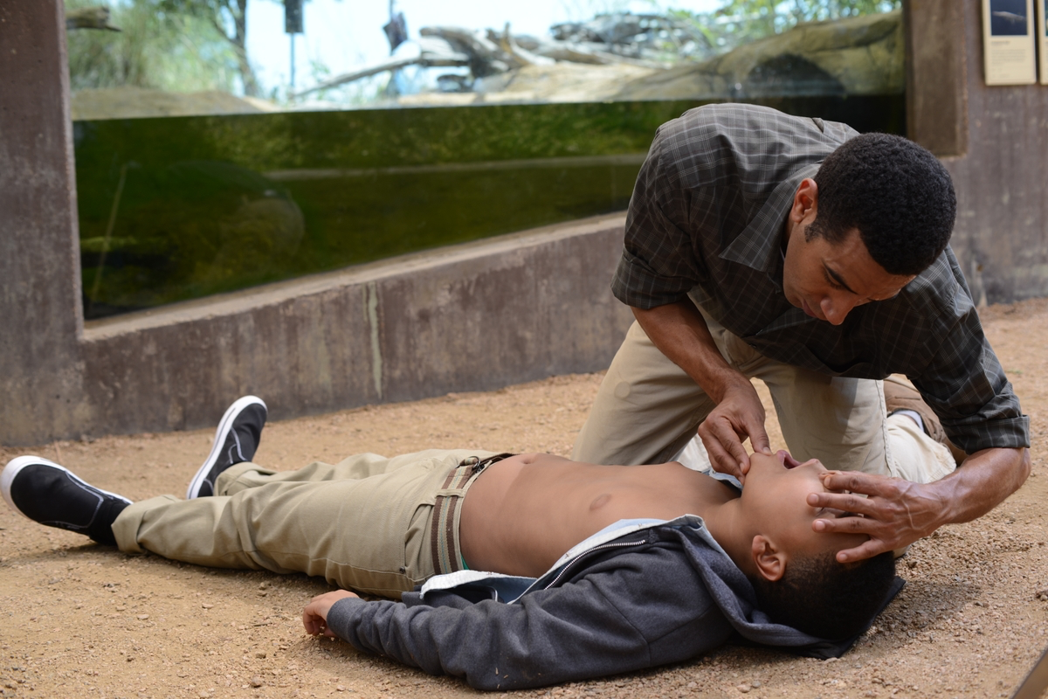
Children are Special
Children are not just small adults
Perform one minute of CPR first
Compressions should not be as deep
Perform easier ventilations
Infants only need small puffs of air
Airway obstructions are more common

Slide 51
Children are Special
Faster compressions are necessary
Never perform a blind finger sweep
Two-person CPR cannot be performed on infants
Handle with care
The need for CPR in infants and children is most often the result of respiratory failure

Slide 52
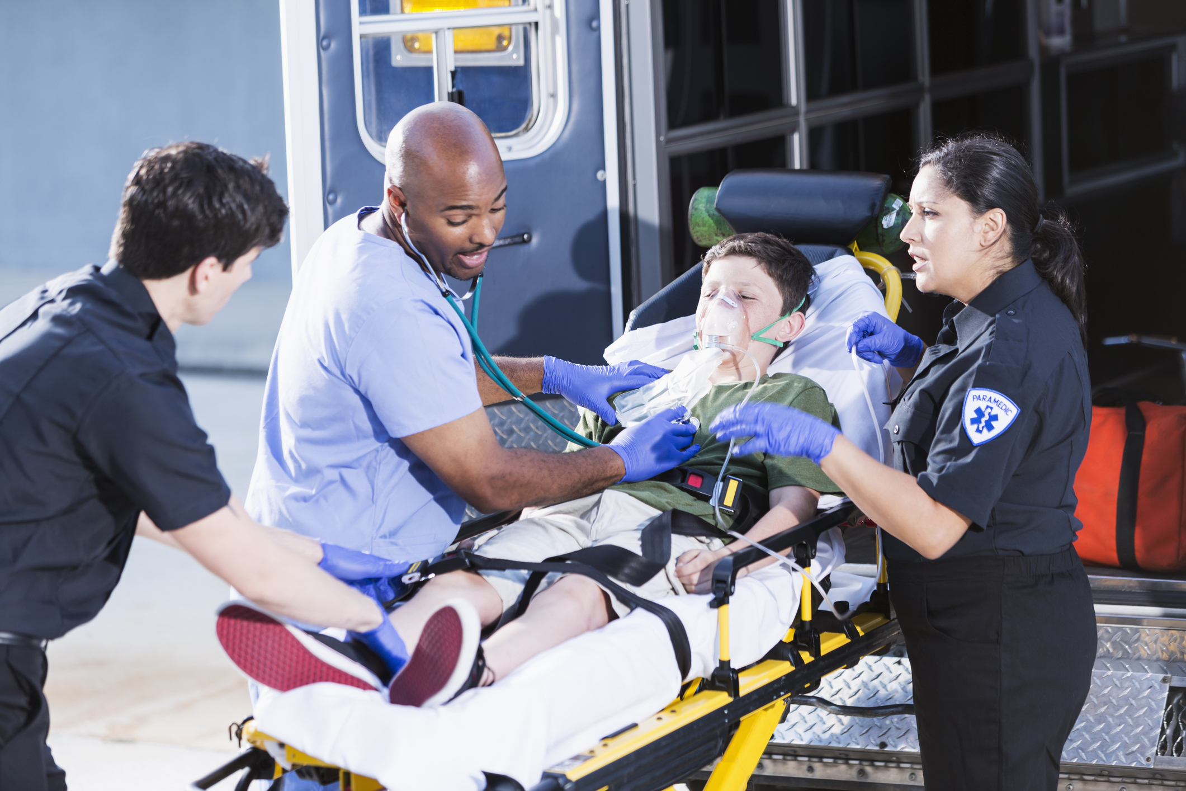
Trauma
Pediatric injury is the leading cause of death in children older than one year of age

Slide 53
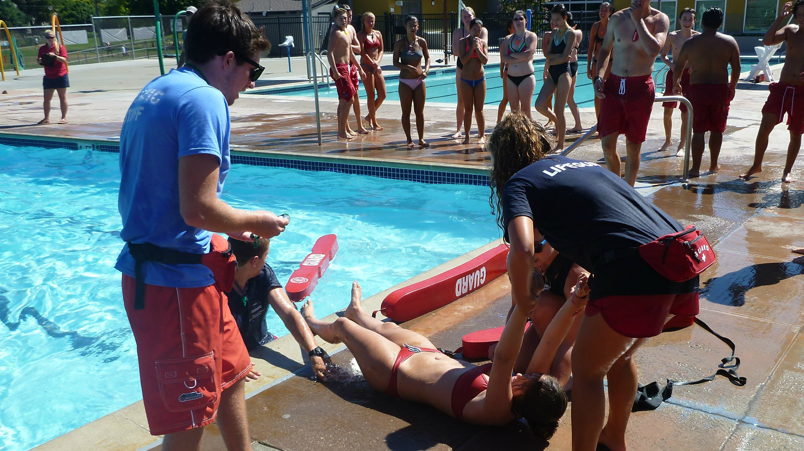
Near Drowning
The first priority after being removed from the water is to begin rescue breathing
Remember: In a drowning, recovery can be complete even later than 10 – 40 minutes after submersion

Slide 54
Do Not Resuscitate (DNR)
Patient has a valid DNR
Patient’s name
Patient’s physician
Date of DNR (only good for one year)
Verification, if possible
When in doubt, perform CPR

Slide 55
When to Stop CPR
Exhausted and unable to continue
Spontaneous pulse and/or respirations resume
Physician pronounces the patient dead
Discussion

Slide 56
Remember: Learn CPR

Slide 57
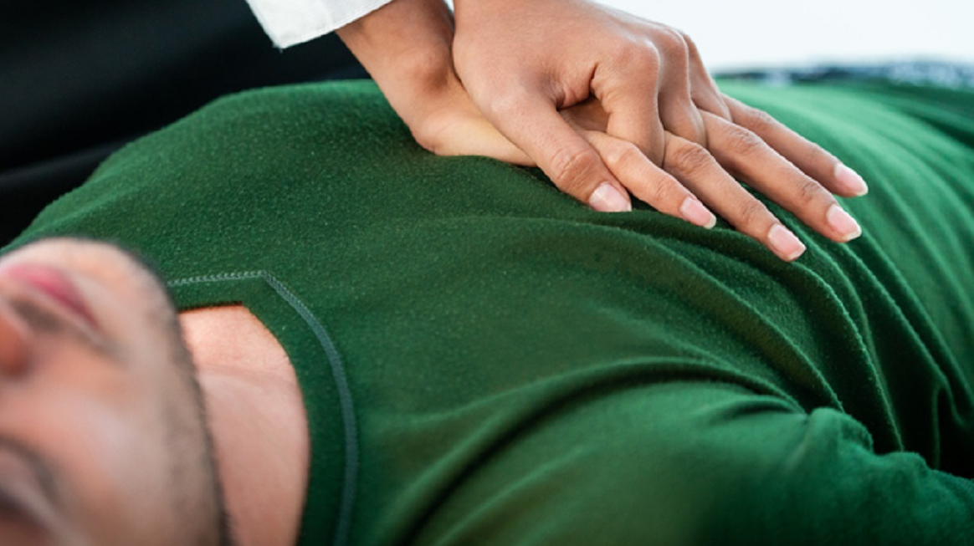
Questions?

Slide 58
Thank you
ISPC
info@ispconline.com
430.201.3201

