Slide 1
Disaster Site Hazard Awareness
The Institute for Safety in Powerline Construction
© Copyright by the Institute for Safety in Powerline Construction 3504 Parliament Ct. Alexandria, LA 71303 All rights reserved. This material or any part thereof may not be reproduced in any form without the written permission of the Institute for Safety in Powerline Construction

Slide 2
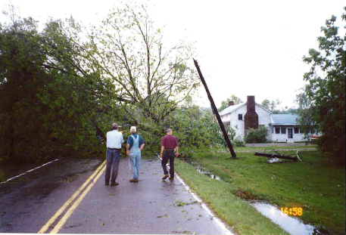
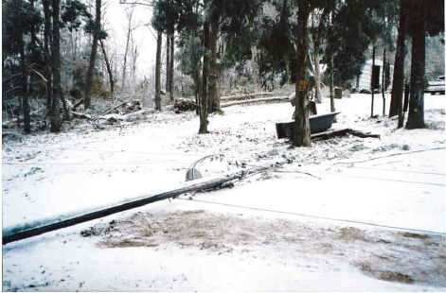
Objectives
To increase hazard awareness during the recovery and repair of storm damage
To inform emergency management personnel of dangers presented by downed power lines
To provide hazard information to those who serve the community during times of crisis

Slide 3
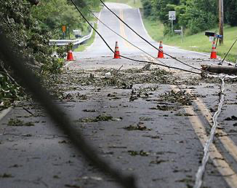
Electricity Basics
Understanding the basics for better awareness
Electricity takes all paths to ground (path to ground principal)

Slide 4
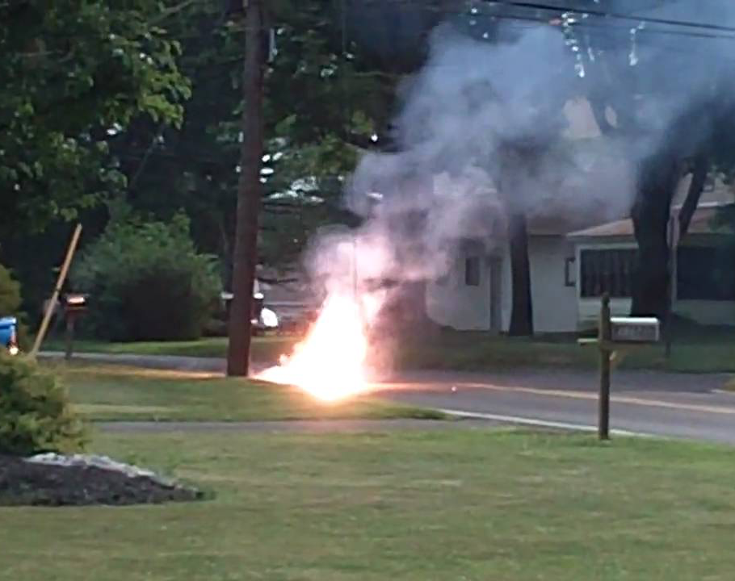
Step Potential
When an energized line touches the ground, the ground may become energized with high voltage
Do not approach the scene!

Slide 5
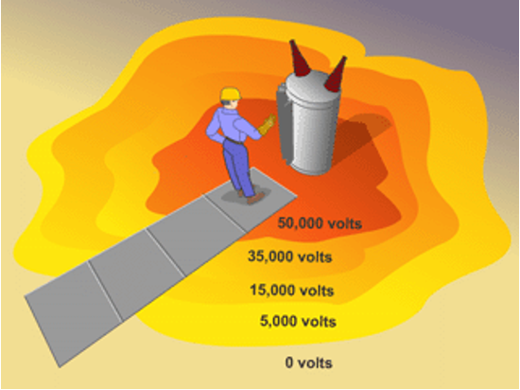
Step Potential
The differences in electrical potential between two points on the earth’s surface, separated by the distance of one pace (3 feet) in the direction of the maximum potential
Notes:
Step potential is caused by a flow of fault current through the earth. In a fault current condition, a current flow causes a voltage drop at the earth’s surface. This happens because voltage and current are inversely proportional. When current rises, voltage drops and vice versa. Grounds will direct fault currents to the earth.
This fault current will radiate outward in circles from the ground connection point or structure. A person standing close to the structure with their feet apart, bridges a part of this current. This places a potential difference between the person’s feet. The methods presently in use to protect a worker in this area is either isolating (nonconductive mat), or a grounding (conducting) mat. An isolating mat will protect the employee by insulating him or her from the earth. A grounding mat, connected to the structure keeps the employee at the same potential as the structure. In either case, the worker must stay on the mat to be protected.
One alternative to mats are rubber overshoes. A problem with over shoes is the the radiant step current may exceed the di-electric rating of the shoe. This could be a problem to persons working on transmission systems where the fault currents may be very high.

Slide 6
Threats: Forces of Nature
Ice Storms and Snow Hazards
Power outages & downed power lines
Fallen trees blocking roads & highways
Always consider a downed line energized
Downed energized lines & step potential
Ice on roadways

Slide 7
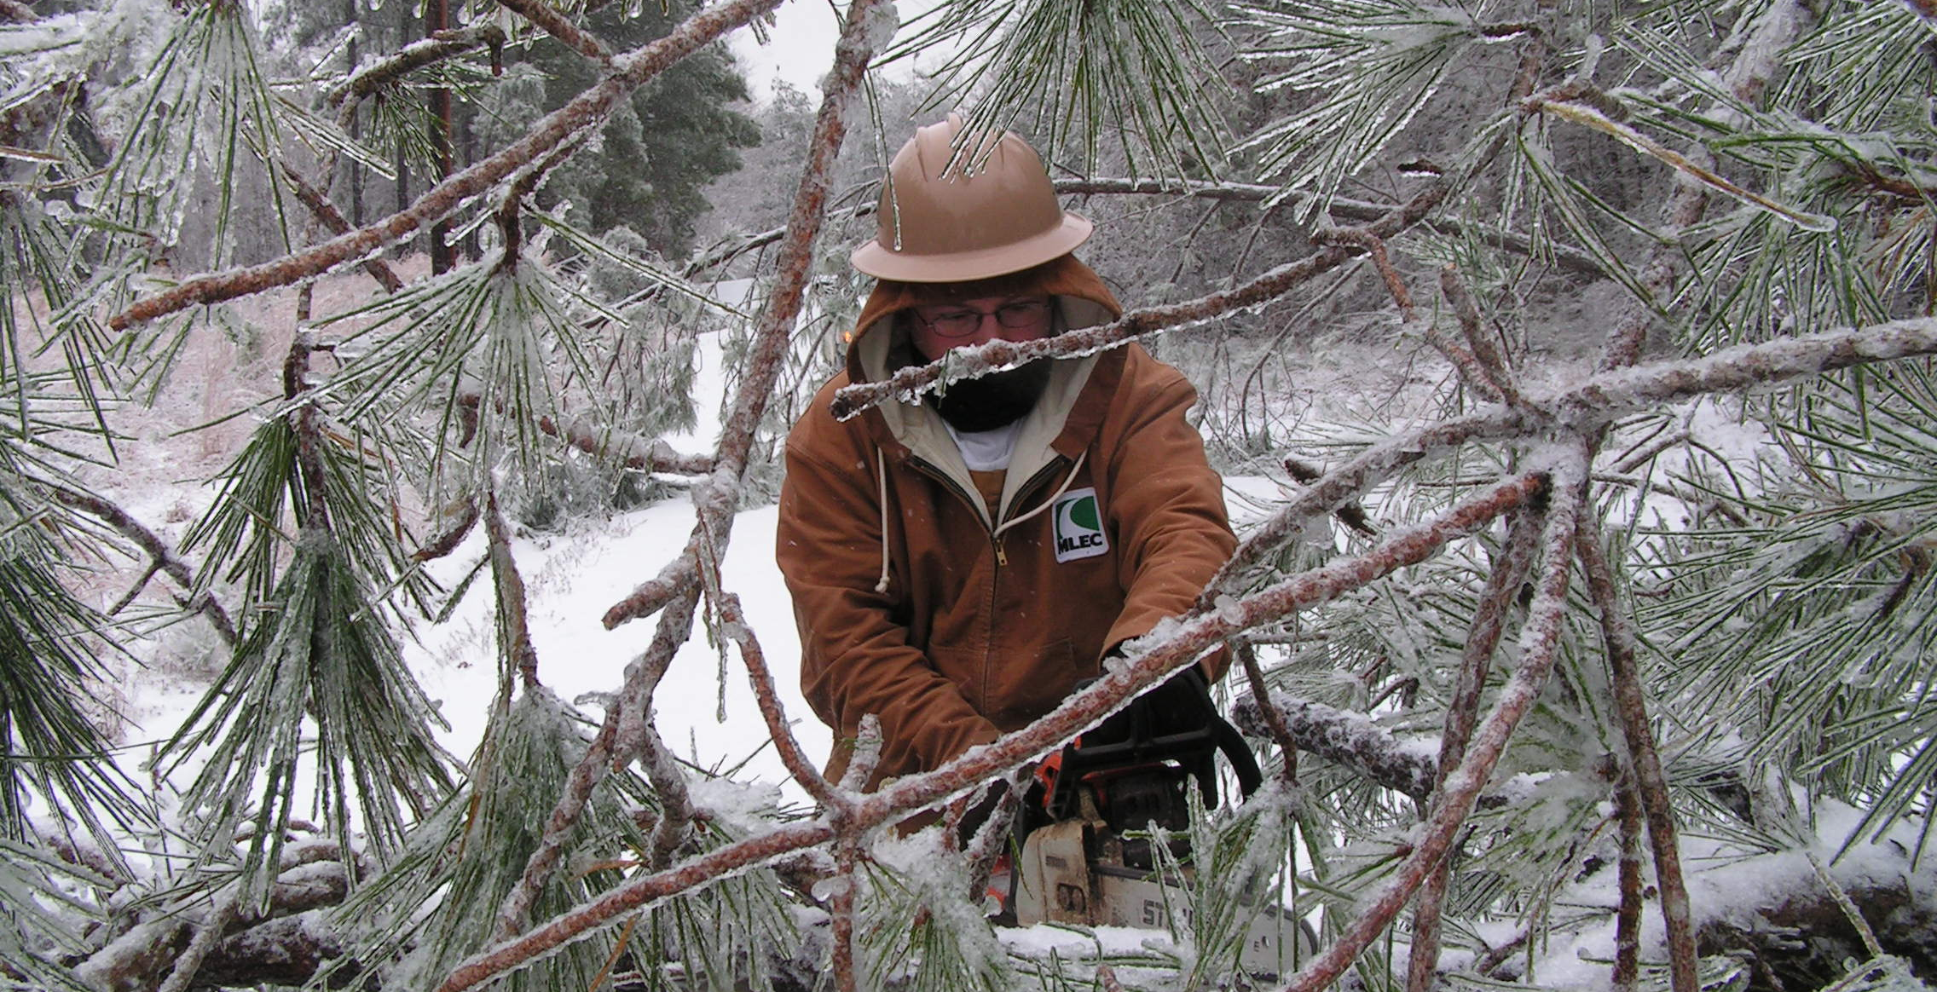

Slide 9
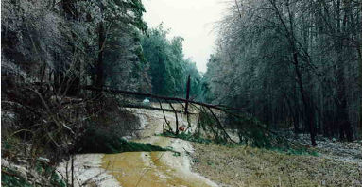

Slide 10
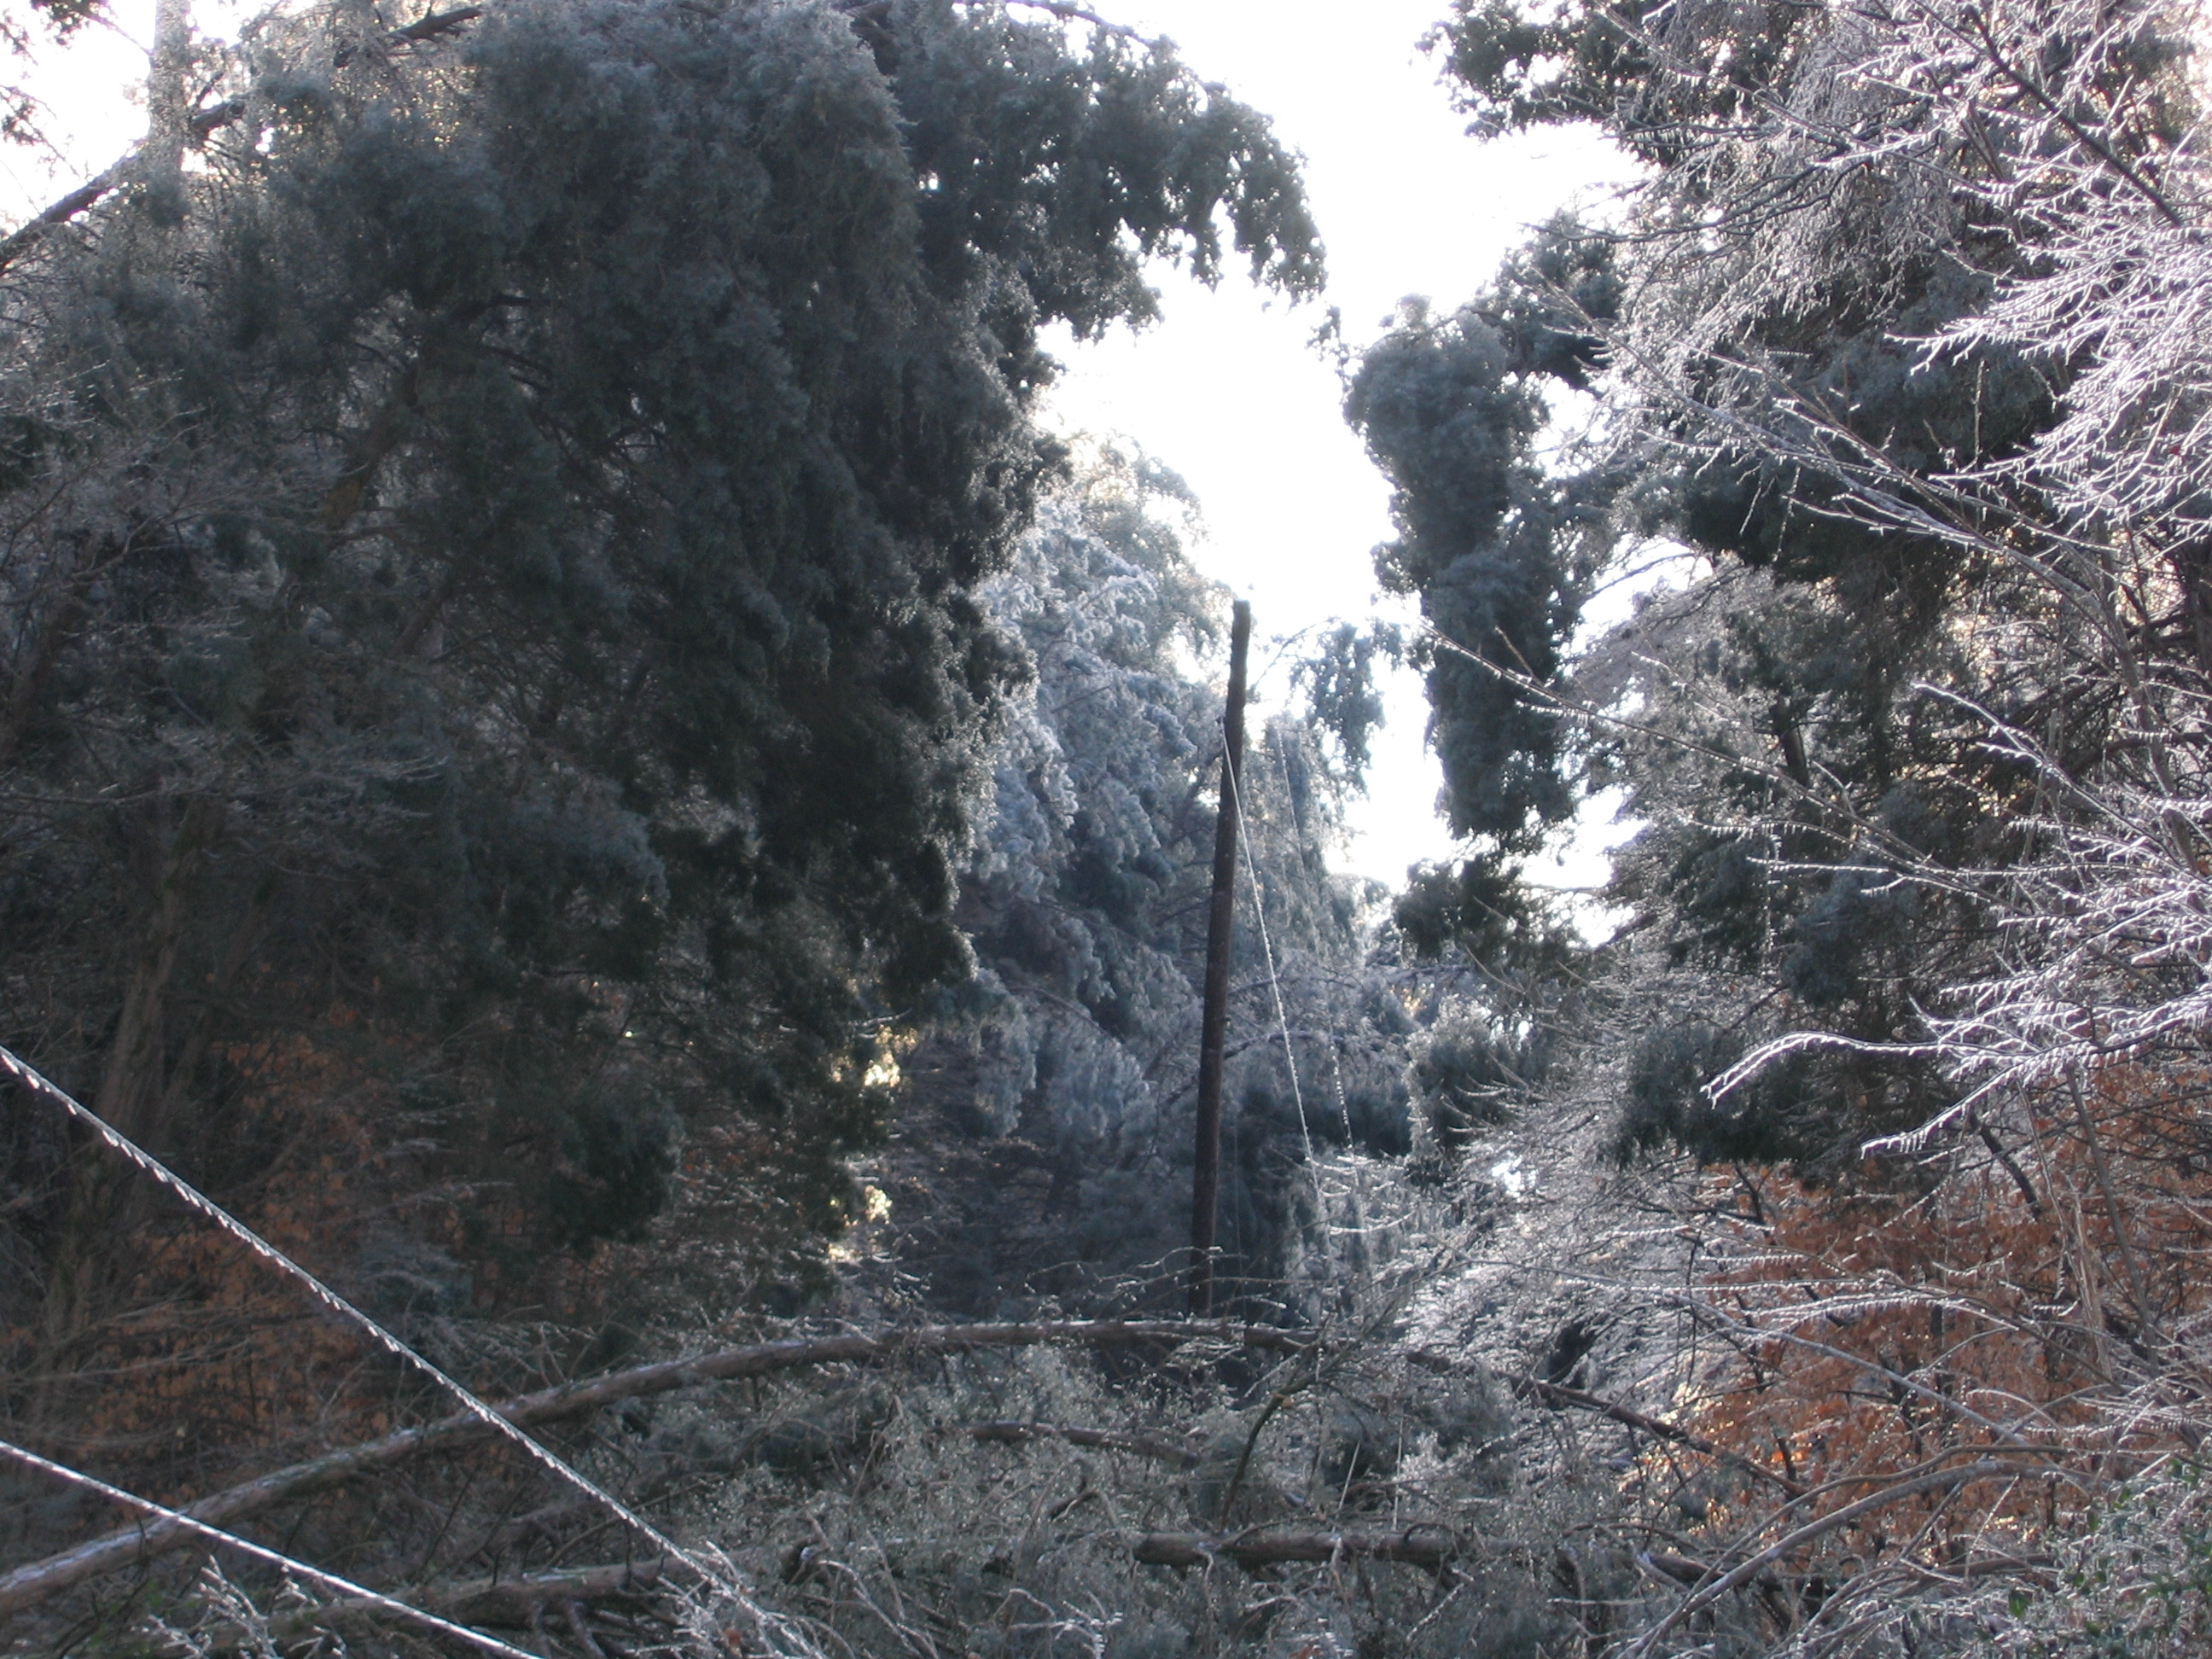

Slide 11
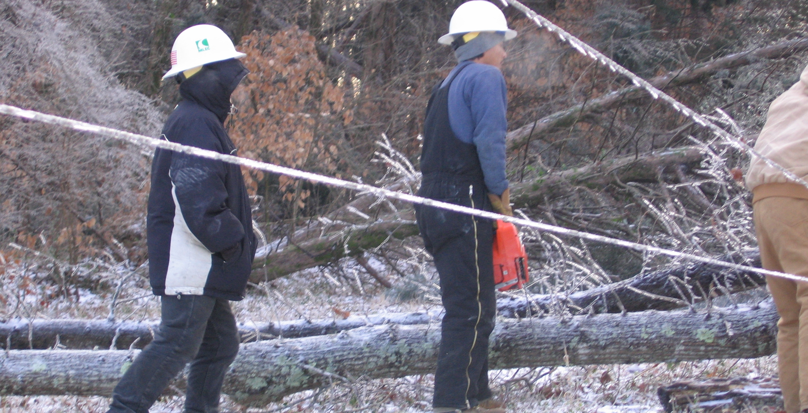

Slide 12
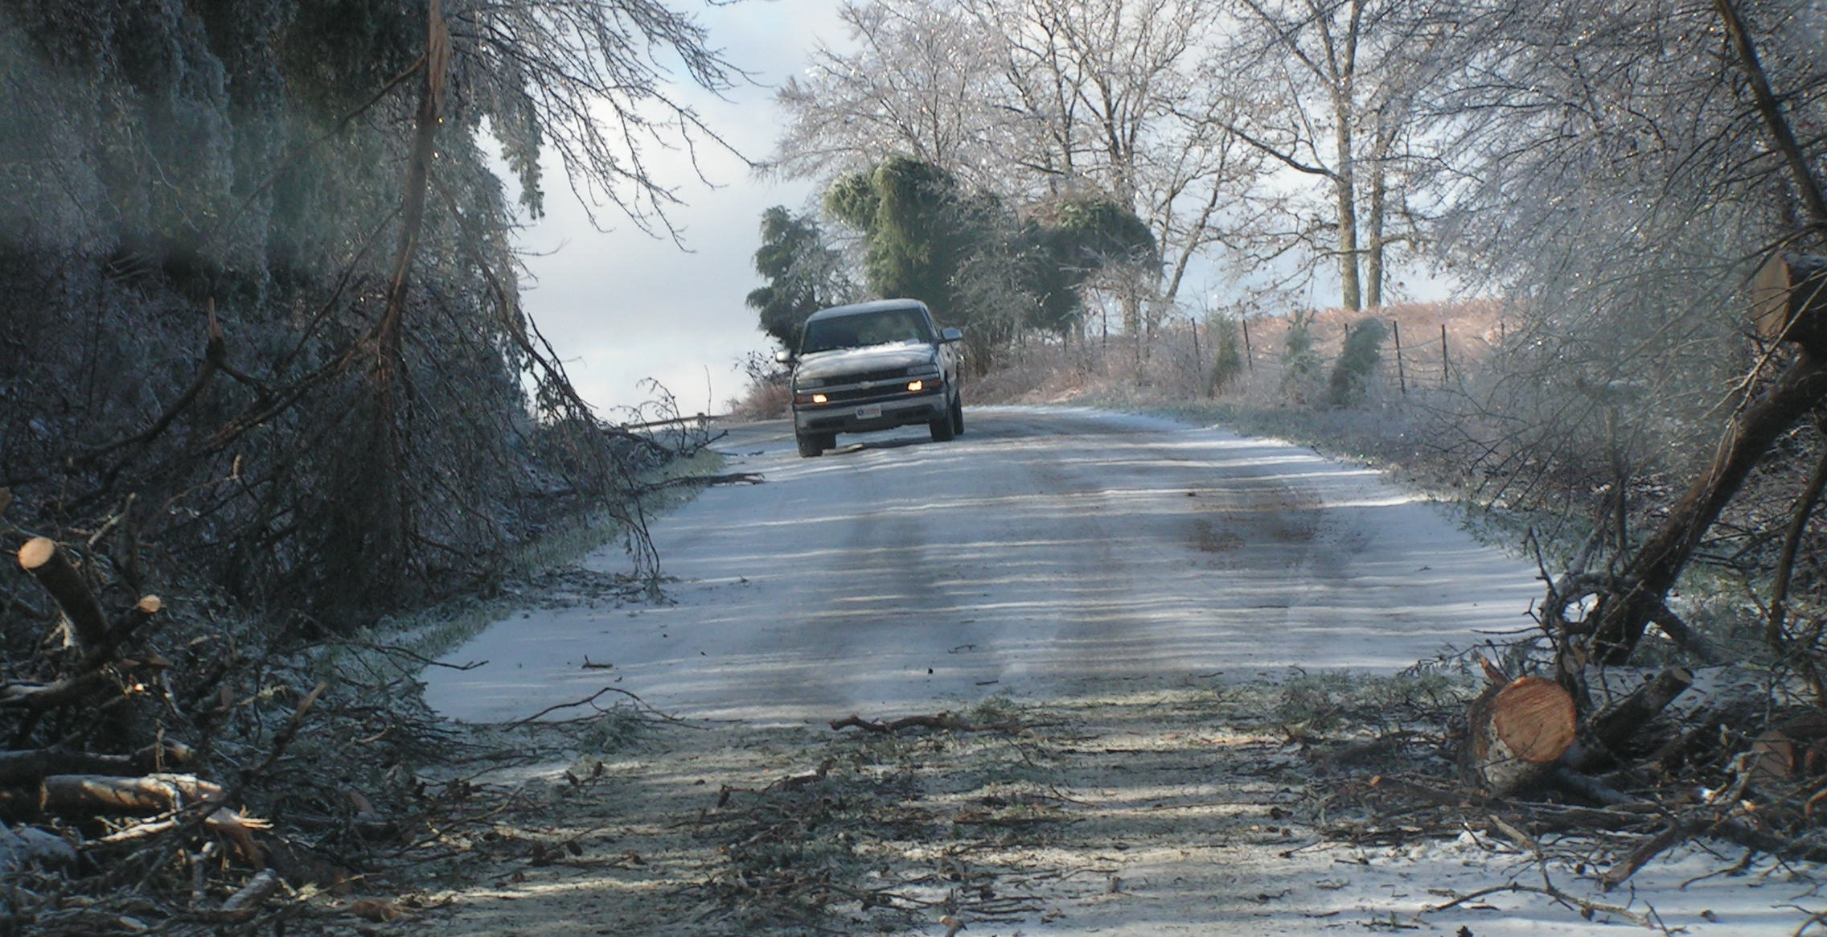

Slide 13
Threats: Forces of Nature
Tornadoes and Straight-Line Wind Hazards
Always consider downed power lines energized
Trees on lines/blocking roads
Downed energized lines and step potential
Flooded roadways

Slide 15
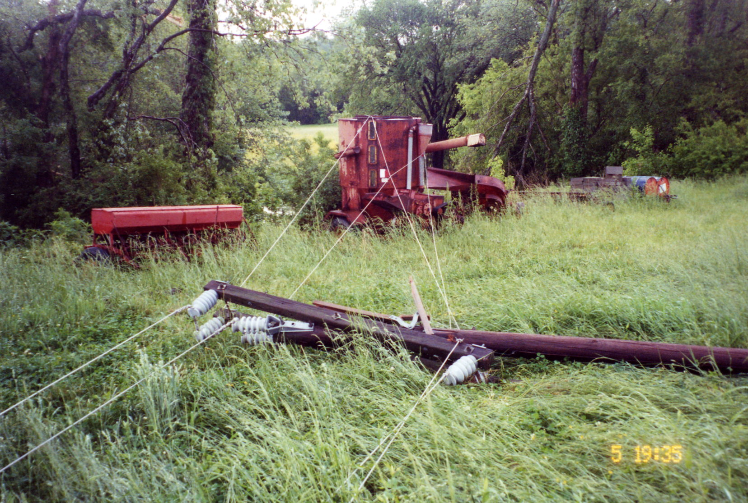
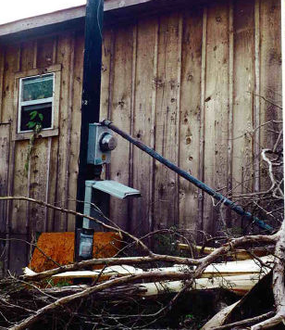

Slide 16
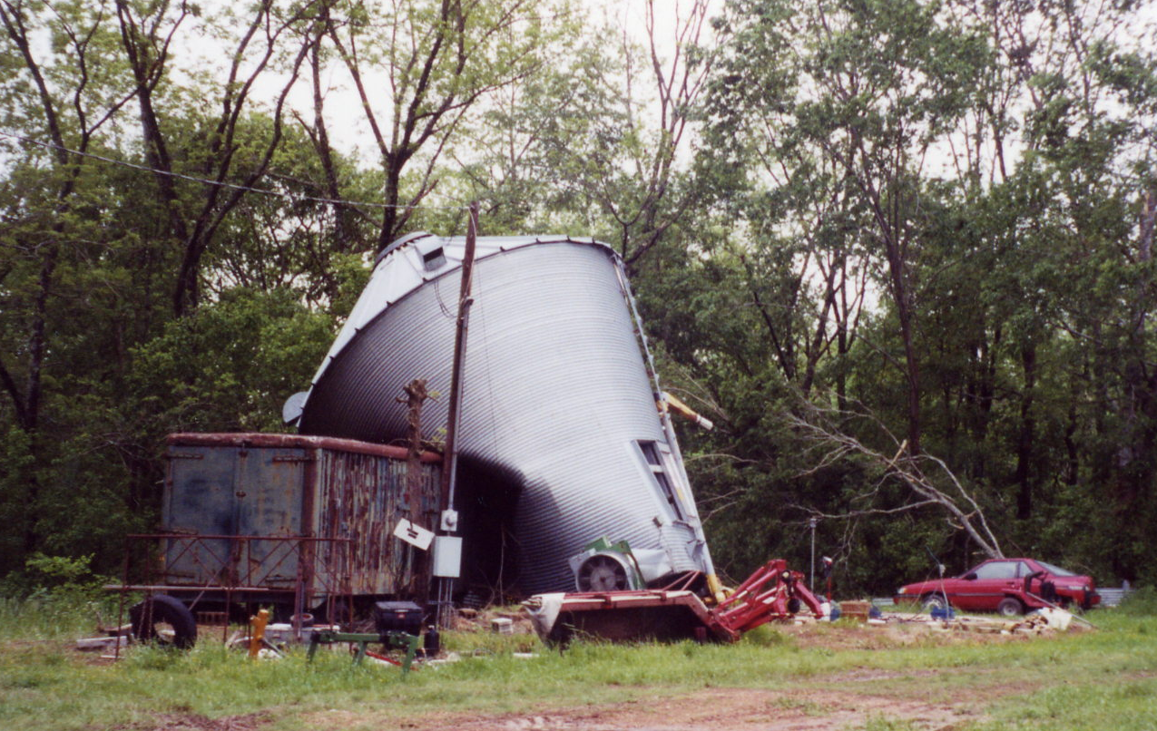
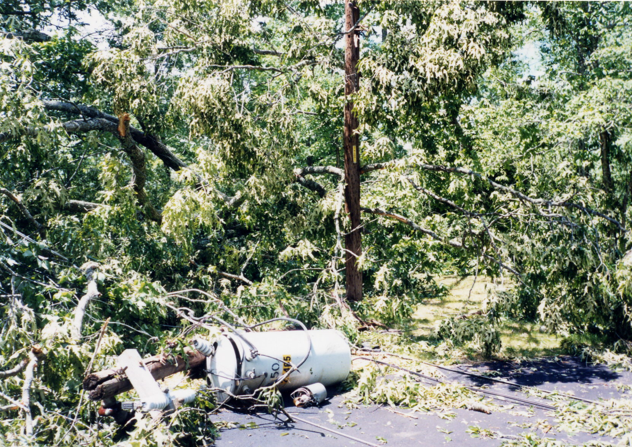

Slide 17
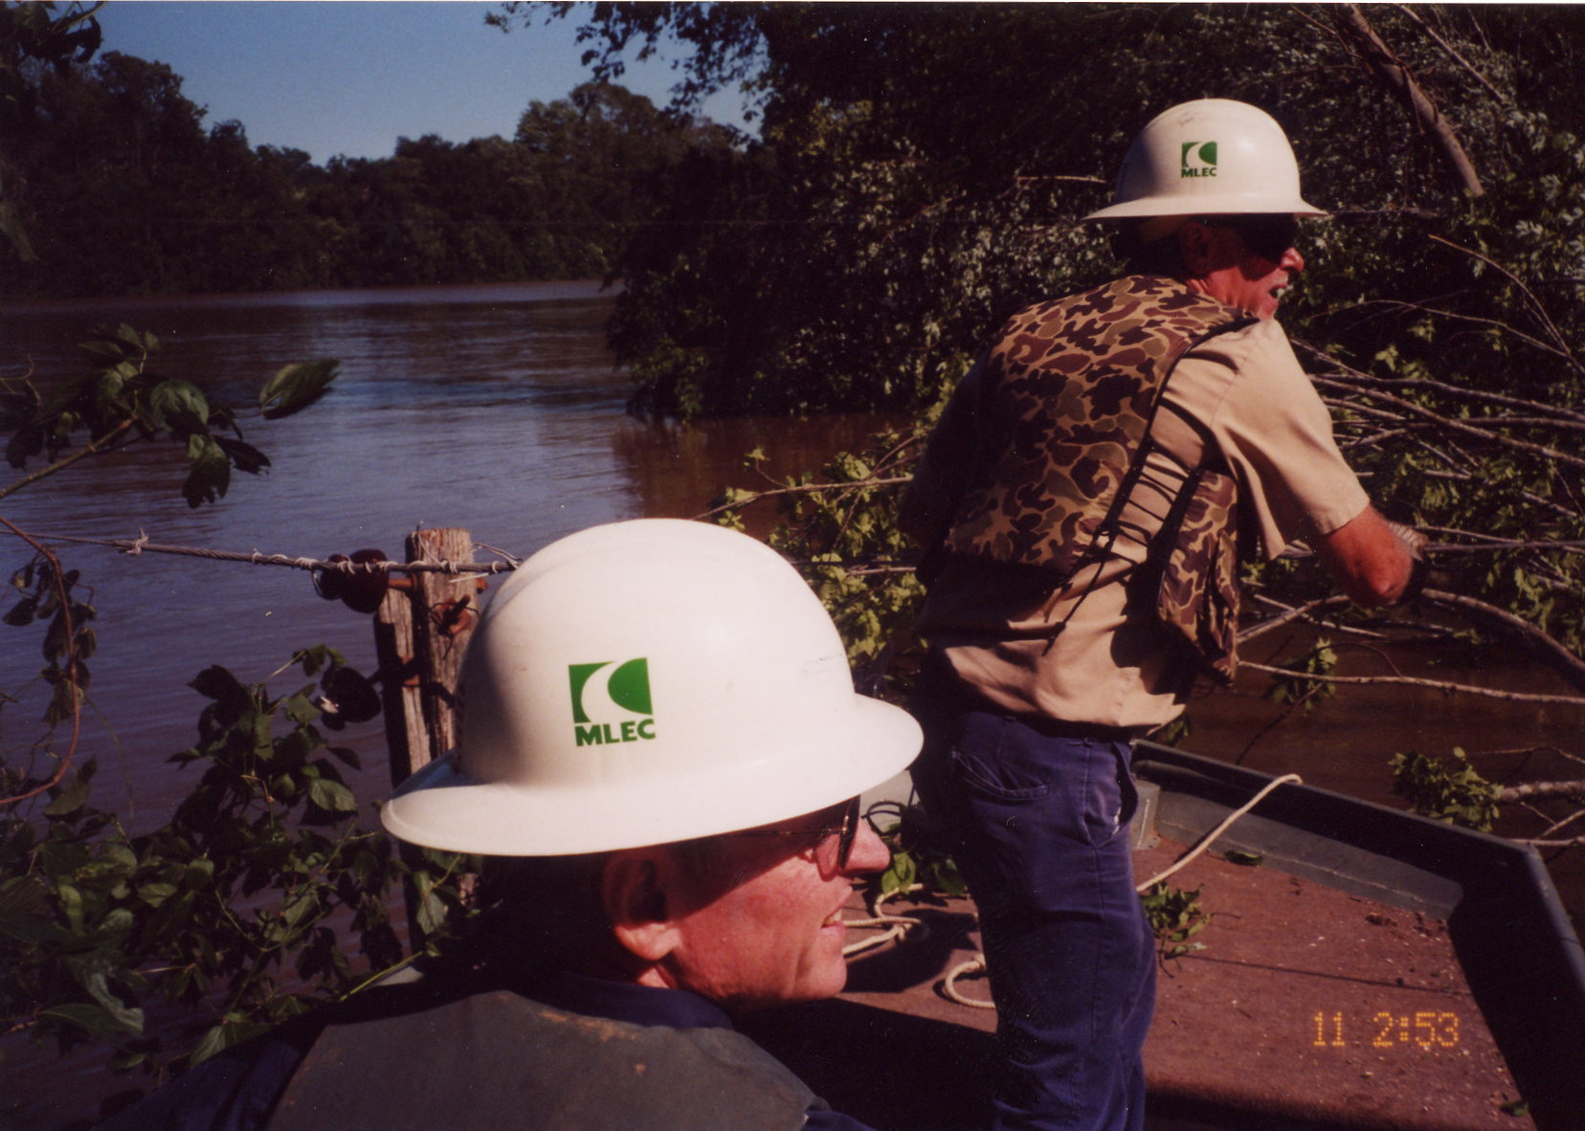

Slide 18
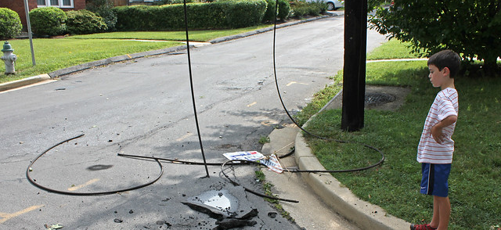
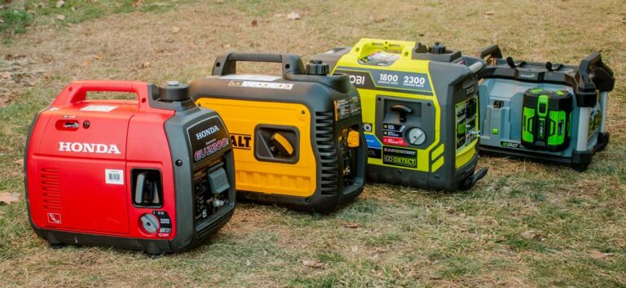
Generators
Hazard Improperly installed generators can back-feed high voltage onto downed lines causing fatal electrocution

Slide 19
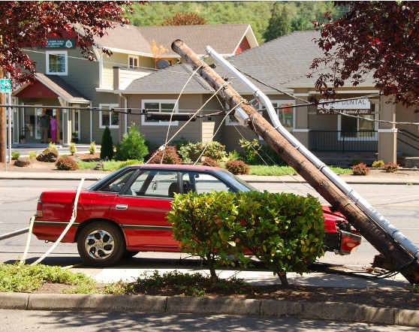
Vehicle Accidents
Beware of energized lines!!!
If you are the first person on the scene of a vehicle accident involving downed power lines use extreme caution! There may still be live energized wires in the area.
Keep everyone clear of the area until it is verified that the power is off!

Slide 20
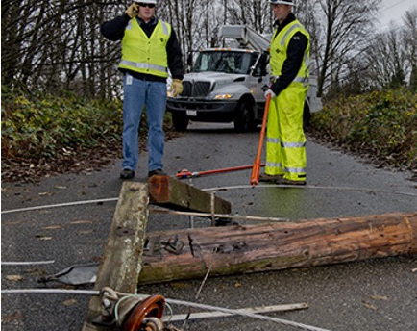
Vehicle Accidents
Be aware of the step potential.
Do not touch any part of the vehicle and the ground at the same time until it is verified that the power is off! You could become a path to ground for high voltage.

Slide 21
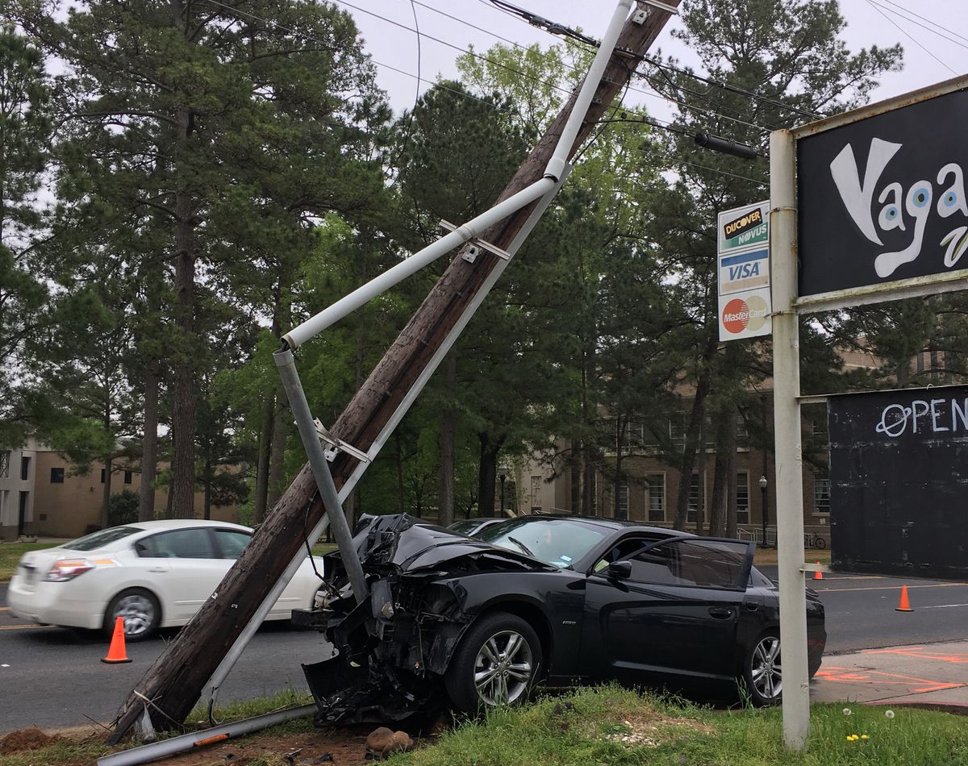
Vehicle Accidents
If there is fire and downed power lines on or near the vehicle, do not use water until it is verified that the power is off.
If there are victims in the vehicle, tell them to stay in the car. Don’t allow victims to move until it is verified that the power is off! They could become a path to ground!

Slide 22
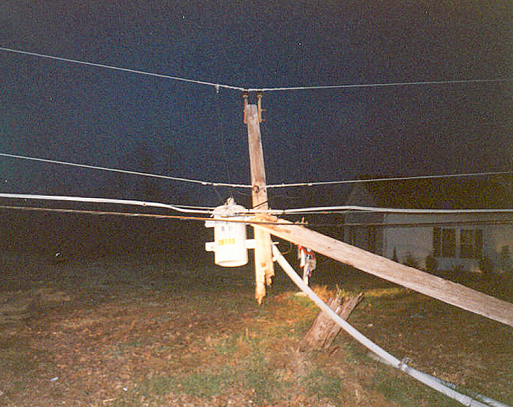
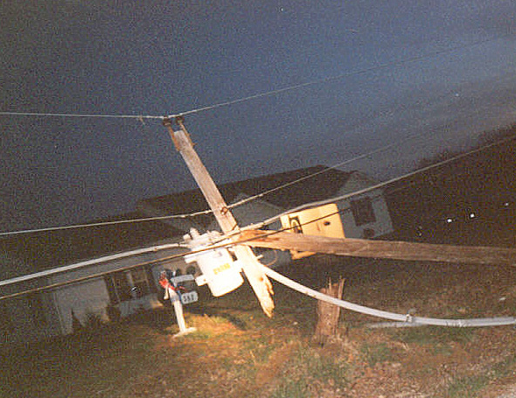
Vehicle accident with broken pole - Energized at 7,200 volts

Slide 23
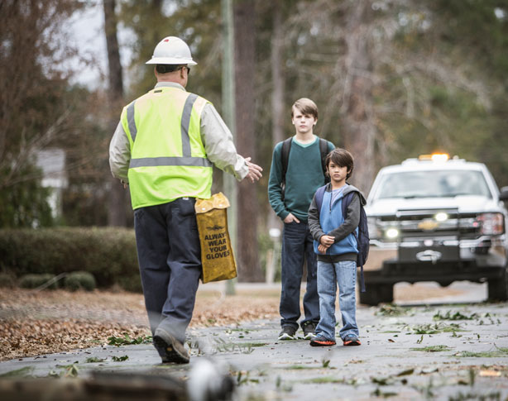
A good reason to recognize hazards and work safe…

Slide 24
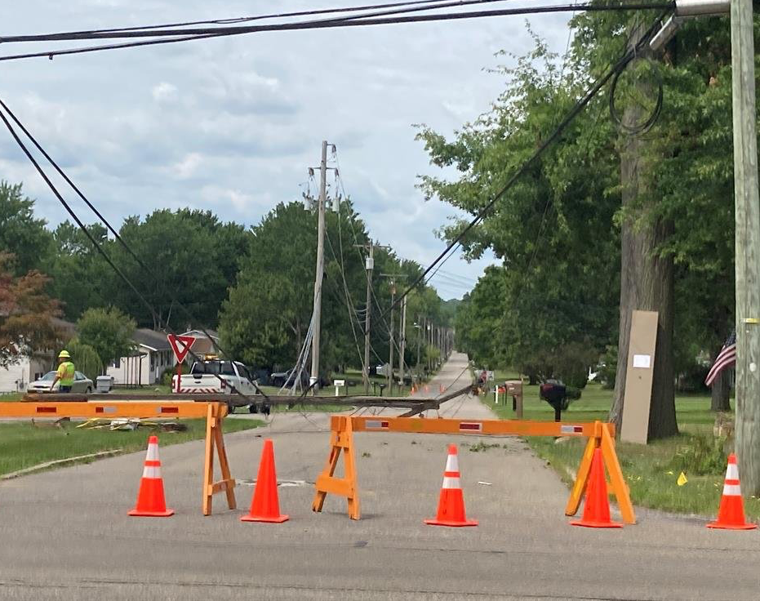
Questions?

Slide 25
Thank you
ISPC
info@ispconline.com
430.201.3201

