Slide 1
Substation Construction Safety
The Institute for Safety in Powerline Construction
© Copyright by the Institute for Safety in Powerline Construction 3504 Parliament Ct. Alexandria, LA 71303 All rights reserved. This material or any part thereof may not be reproduced in any form without the written permission of the Institute for Safety in Powerline Construction

Slide 2
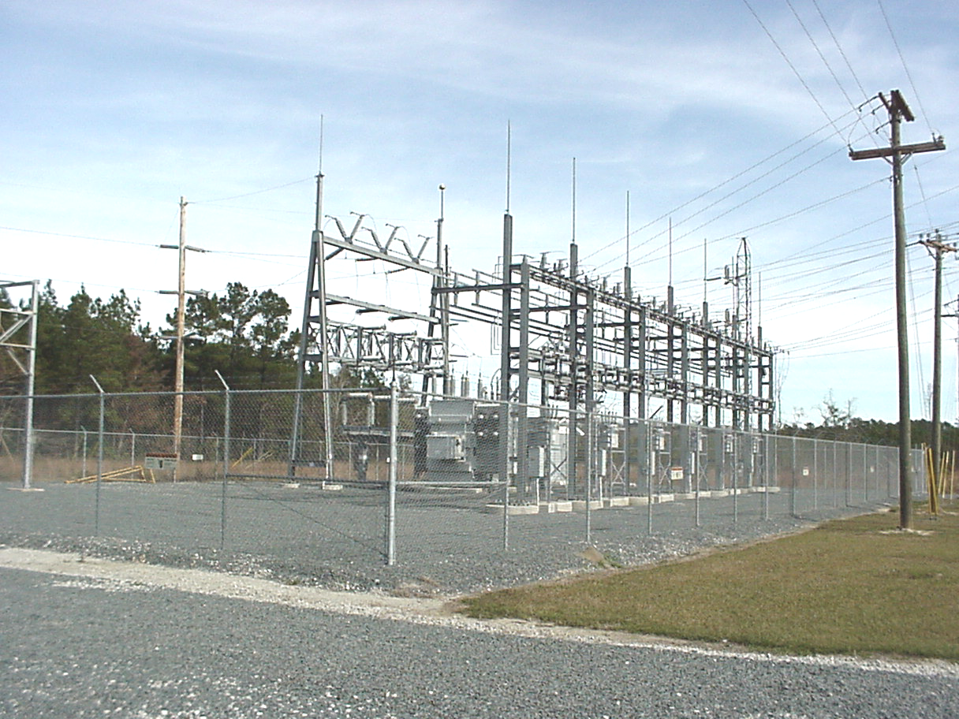
Purpose
To train contractors/ employees on applicable:
OSHA standards
Basic substation facilities
Company policies
Provide and maintain training documents
29 CFR Part 1926.957

Slide 3
Goal
Prevent incidents that may result in:
Service interruptions
Equipment damage
Injury
Fatal injuries
Safety training for employees who work in energized substations

Slide 4
Objectives
As a result of this training session, participants will have better knowledge and be able to:
Apply standards and policies to the work area
Identify basic components of a substation
Identify energized and non-energized components
Understand minimum approach distances
Know the requirements of barricading and barrier application

Slide 5
Obtaining Authorization
Pre-construction/work briefing
Site visit
Entry/exit notification
Substation security

Slide 6
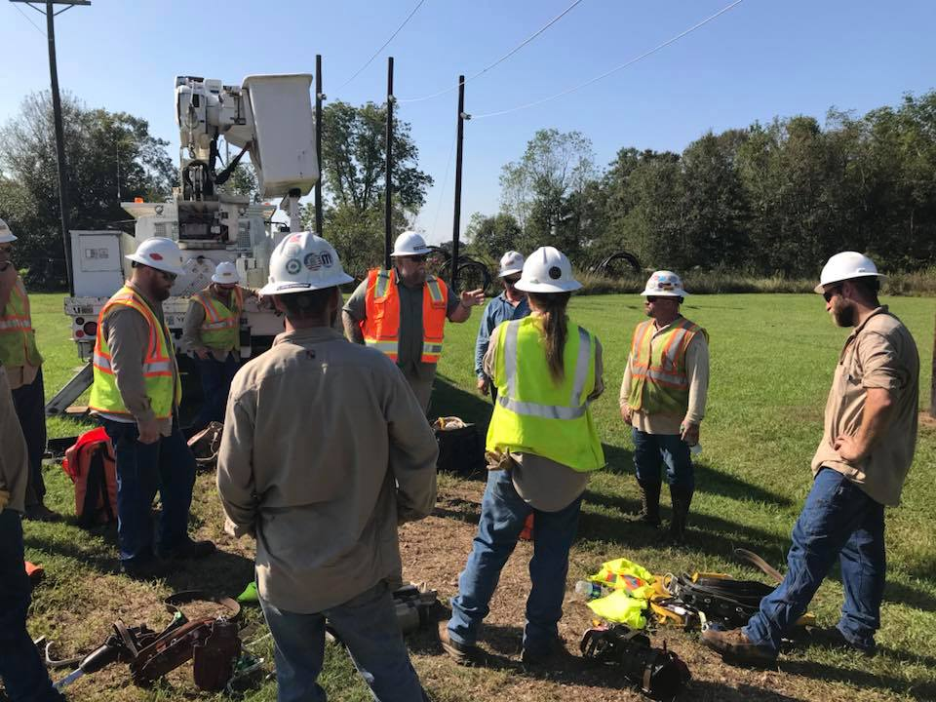
Pre-construction Briefing
Joint meeting between utility representative and the contractor
Review site plans
Work schedules
Communication procedures
Equipment use and needs
Safety precautions and measures

Slide 7
Personal Protective Equipment
Head Protection
Hard hat
Non-constructive rating
Adjusted properly
Worn at all times
OSHA 1910.135

Slide 8
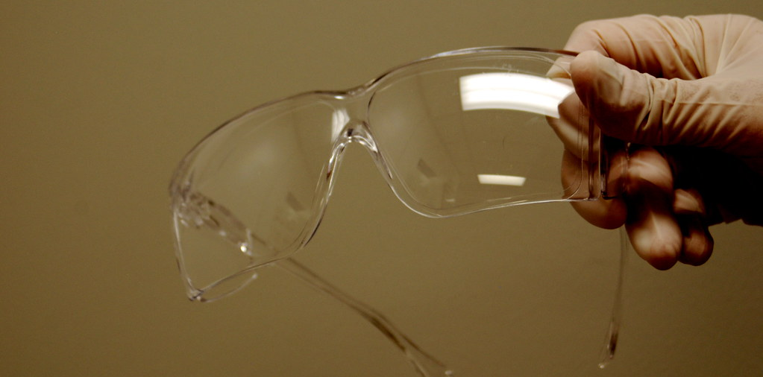
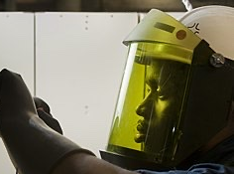
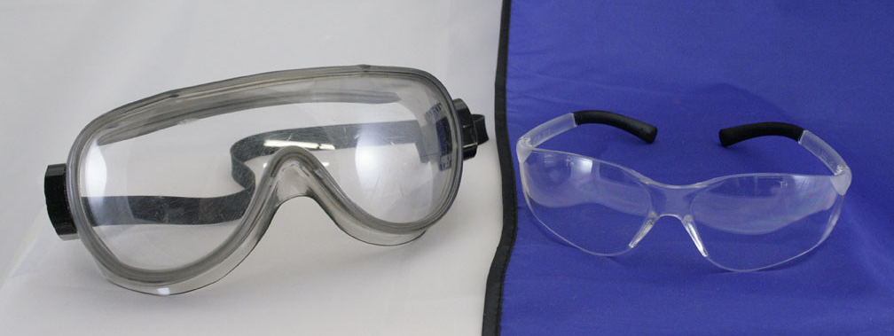
Personal Protective Equipment
Eye and Face Protection
Face shield
Safety glasses
Safety goggles
OSHA 1910.133

Slide 9
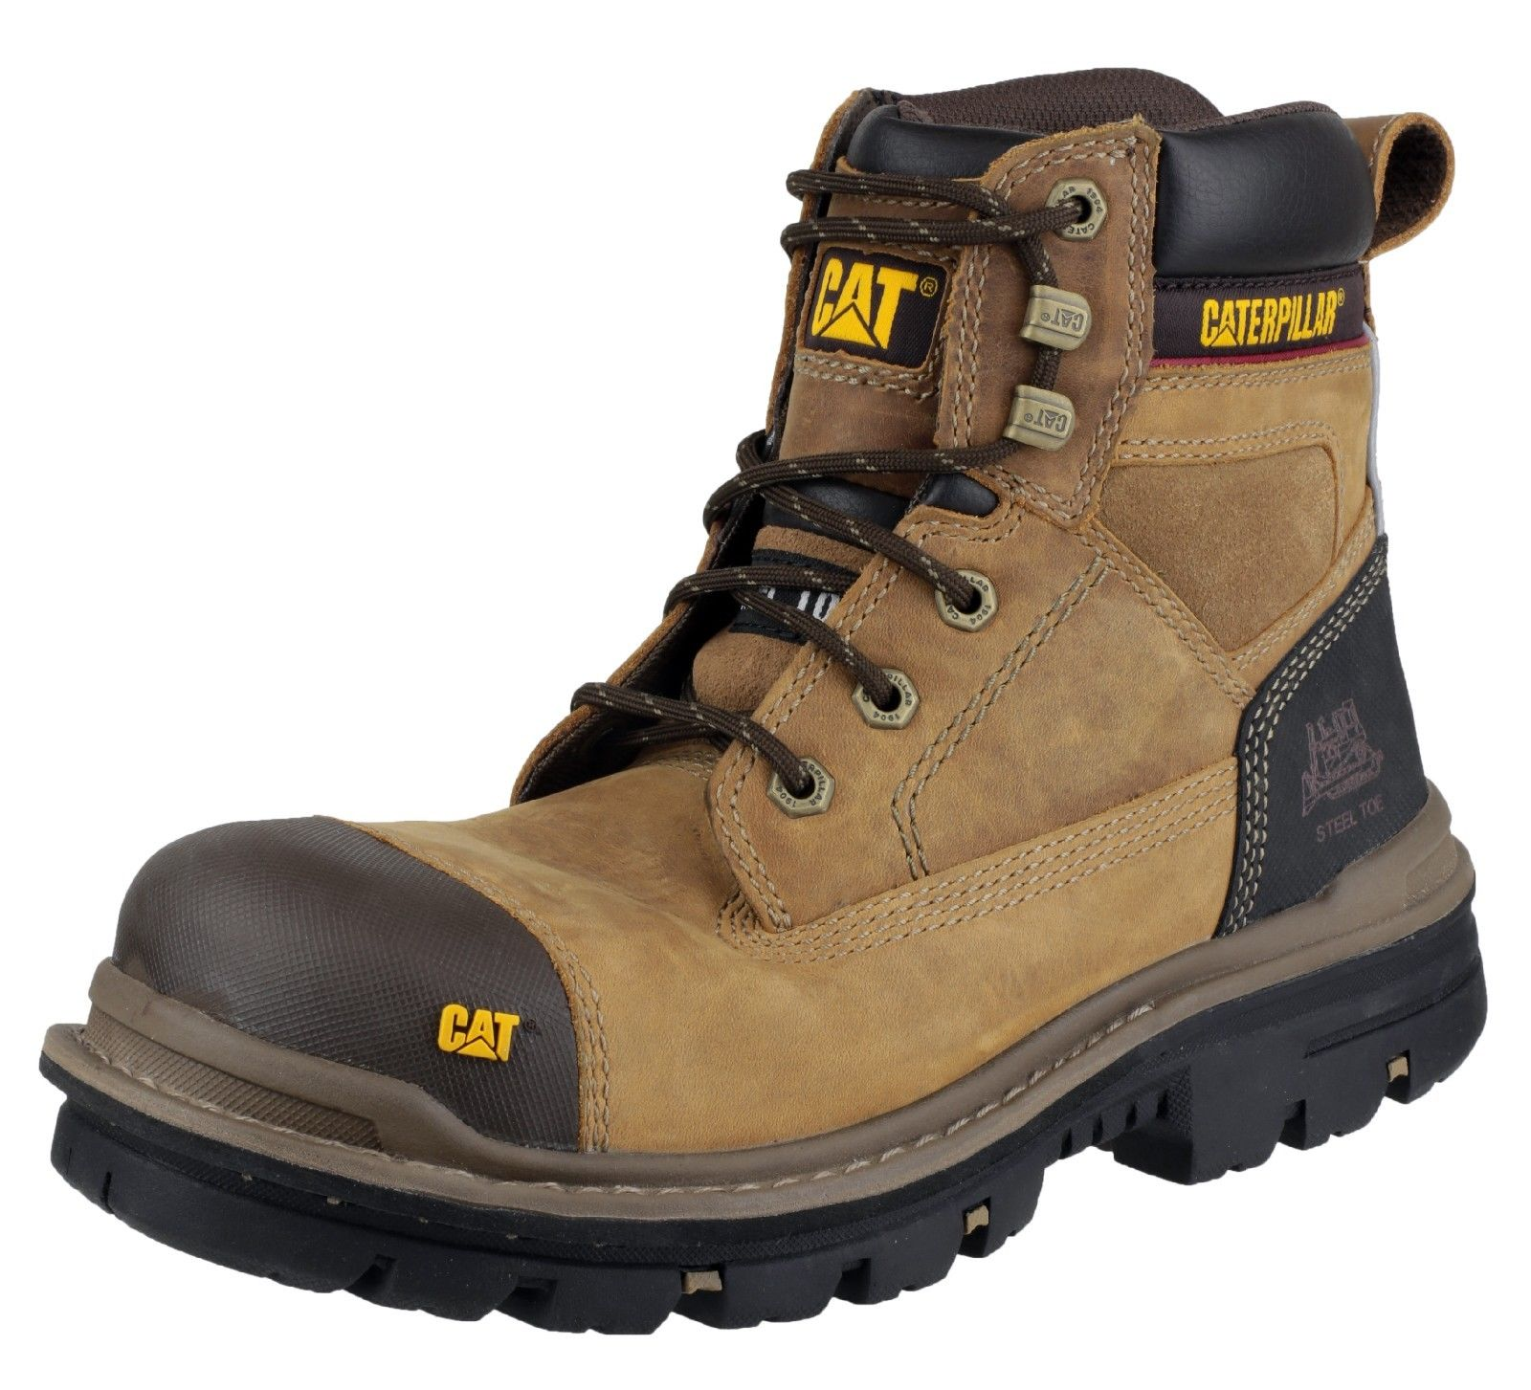
Personal Protective Equipment
Foot Protection
Electrical hazard rating
Toe protection
OSHA 1910.136

Slide 10
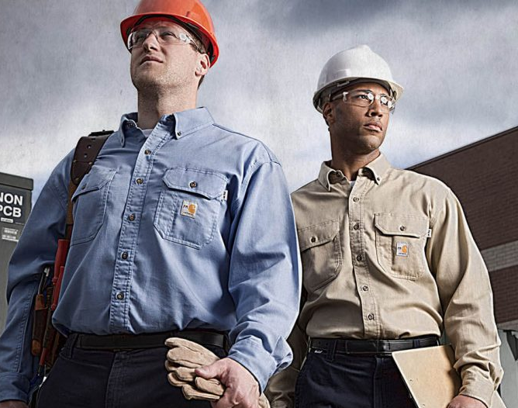
Personal Protective Equipment
Protective Clothing
Required by OSHA
Fire retardant
Fault current rated
Worn in substations
OSHA 1910.269 (L)(6)(i)

Slide 11
Personal Protective Equipment
Insulating Equipment
Rubber gloves
Insulating switching sticks
Insulated cover up material
OSHA 1910.137

Slide 12
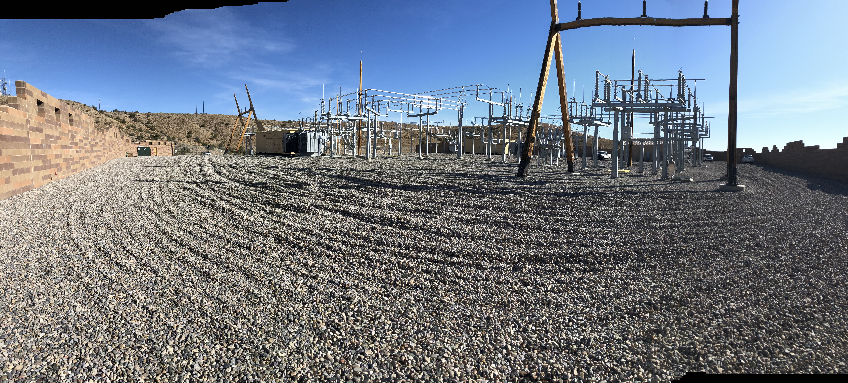
Site Visit
Each substation is constructed differently
During a site visit, job plans can be reviewed
The substation configuration and energized facilities can be identified

Slide 13
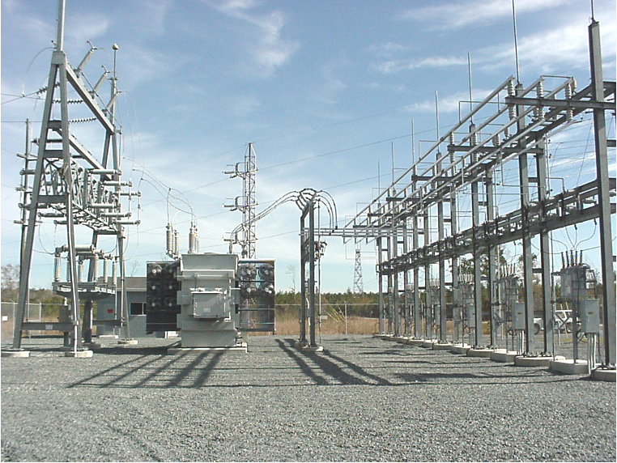
Substation Components
Transmission feeds
Transformers
Buss work
Steel structures
Distribution feeds
Fencing

Slide 14
Transmission Feed
Safely working in energized substations depends upon:
Well-trained employees
Knowledge of safety procedures and safety equipment
Proper communication
SAFETY is the TOP PRIORITY!

Slide 15
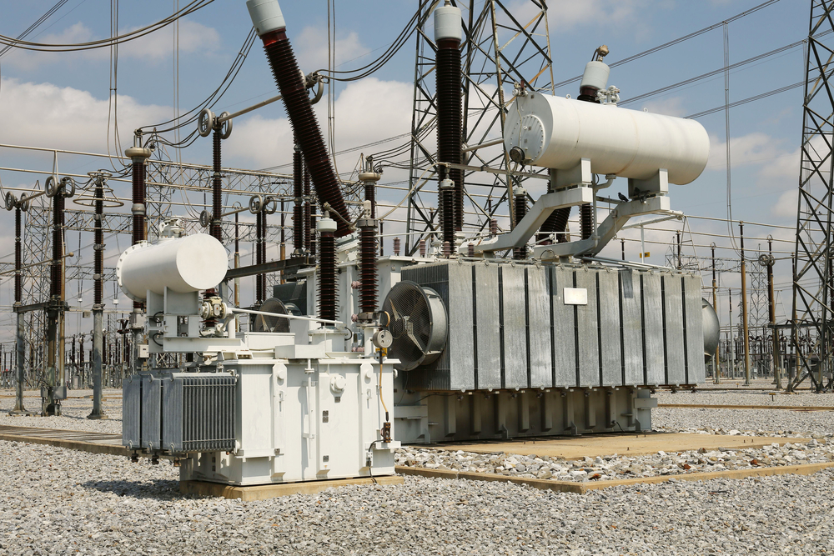
Transformers
Transformers in a substations are grounded on all four corners
Grounds serve to dissipate amperage flow
Always be aware of differences of potential

Slide 16
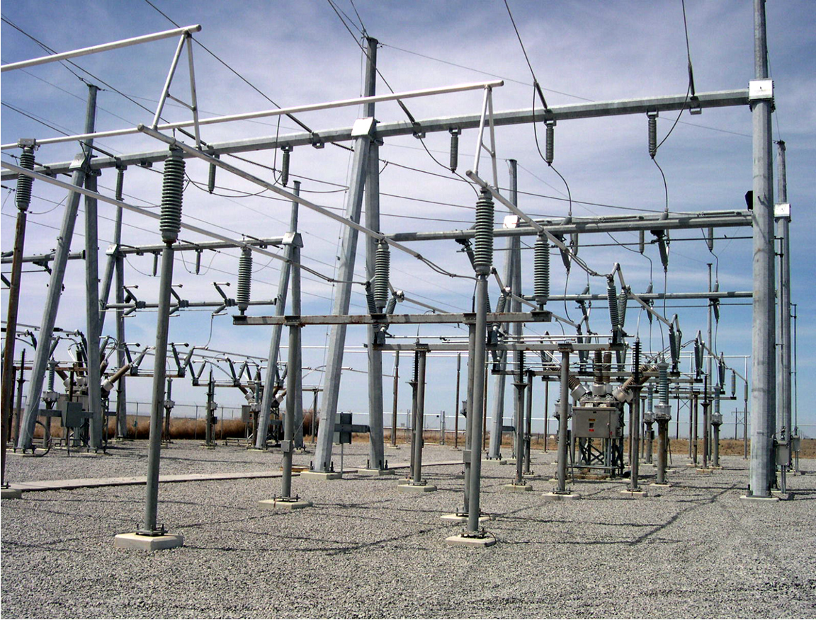
Bus Work
Never carry anything overhead inside a substation

Slide 17
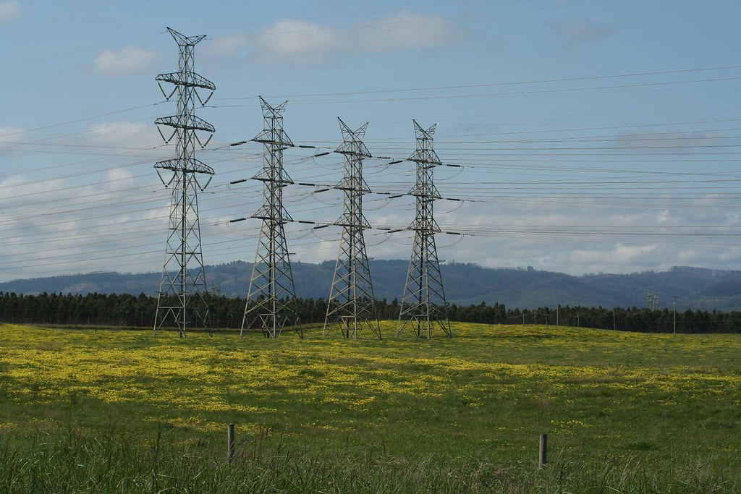
Steel Structures
Recognizing hazards associated with steel structures is very important
Always perform thorough inspection of each structure
Never touch a steel structure until it is identified as having no differences of potential

Slide 18
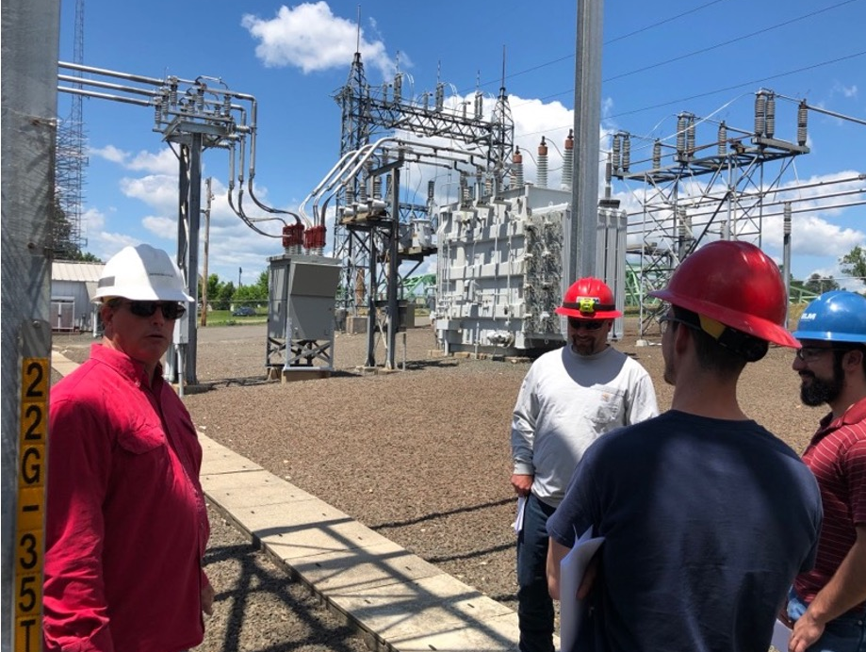
Distribution Feeds
Distribution feeders are typically lower than transmission feeders

Slide 19
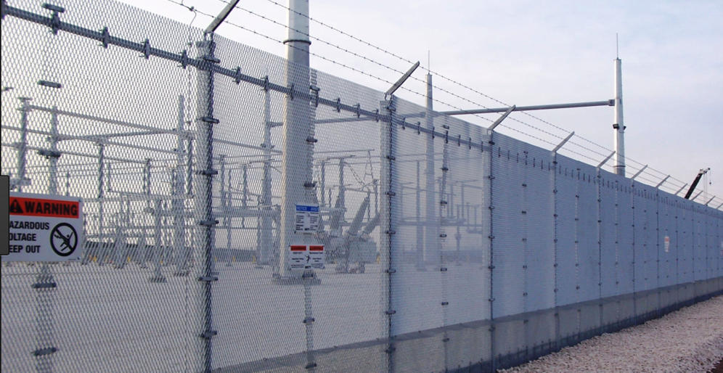
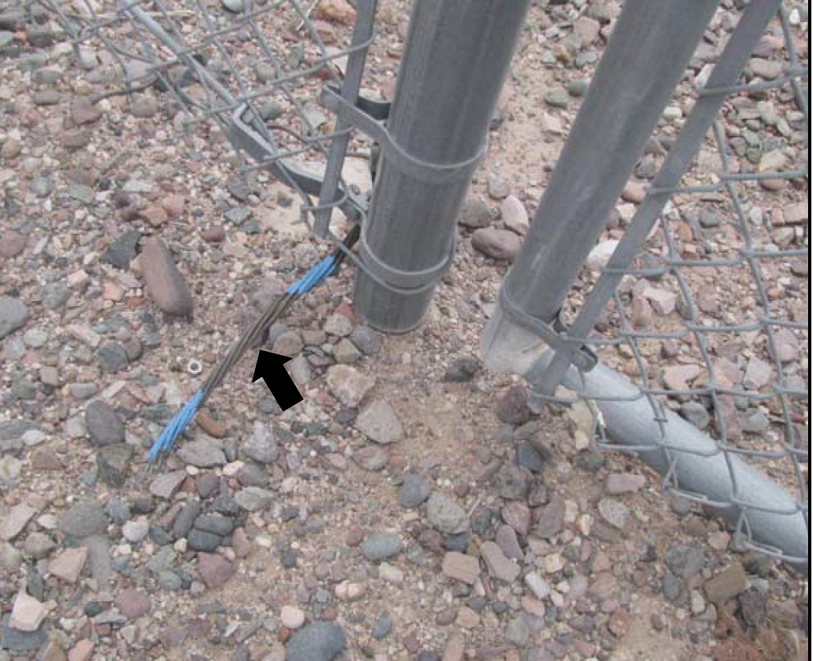
Fencing
Gates and fencing in a substation should be bonded together and to the ground grid

Slide 20
Thank you
ISPC
info@ispconline.com
430.201.3201

