Slide 1
Digger Derrick Operator Training
The Institute for Safety in Powerline Construction
© Copyright by the Institute for Safety in Powerline Construction 3504 Parliament Ct. Alexandria, LA 71303 All rights reserved. This material or any part thereof may not be reproduced in any form without the written permission of the Institute for Safety in Powerline Construction

Slide 2
Objectives
Upon completion of this lesson, the trainee will understand:
basic attention signage associated with a digger derrick
the basic parts of a digger derrick
daily maintenance requirements for working on a digger derrick
the hand signals associated with the proper operation of a digger derrick
some of the basic safety issues associated with a digger derrick

Slide 3
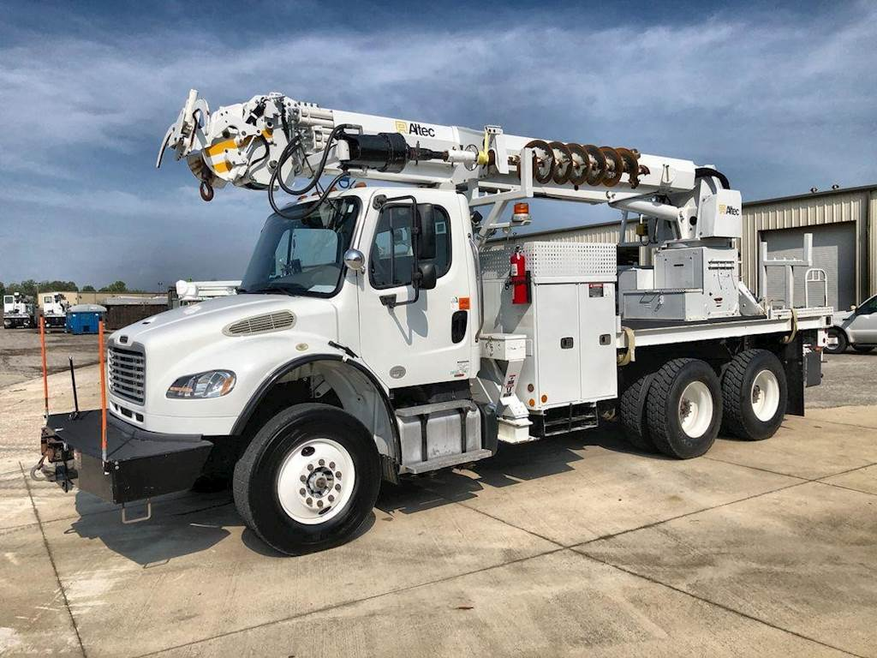
Outline
Safety Statements
Definitions
Parts of the Digger Derrick
Daily Inspection
Hand Signals
Job Safety Analysis

Slide 4
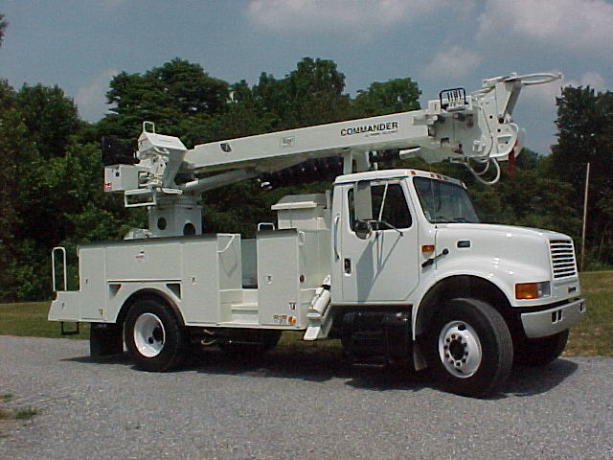
Definition OSHA 1910.181
A derrick is an apparatus consisting of a mast or equivalent member held at the head by guys or braces, with or without a boom, for use with a hoisting mechanism and operating ropes.

Slide 5
Your Safety Manual
In the absence of any specific rule or regulation in this manual, the regulations and requirements of OSHA, ANSI or ASTM, National Electric Safety Code, State, County, and local shall be followed. (Latest edition)
Each employee must share the responsibility for their own personal safety and that of fellow employees. It shall be the duty of each employee to read, understand and comply with the provisions of this safety manual that pertains to their work.
Failure to do so will be considered willful violation of safety rules and cause for disciplinary action up to and including termination. It shall be the duty of the immediate supervisor or person in charge to require all employees to comply with safety rules and no ensure that safe work practices are being carried out.
Employees must be trained and familiar with safety related work practices, rules, procedures and other requirements relating to their work.
Supervisor's responsibility shall be to maintain a safe work environment free of recognized hazards for employees working under their supervisors.
It is the responsibility of all supervisors regardless of title or classification to require all employees working under their direction to comply with all applicable safety rules and safe work practices, whether or not covered by the provisions of this safety manual.

Slide 6
Your Safety Manual
It shall be the responsibility of the supervisors and person in charge to see that:
All working conditions are safe.
All tools and equipment are in good condition, carefully inspected, and meet industry standards.
Work is carried out in accordance with the safety procedures outlined in this manual.
No one shall be permitted to do any work without using the proper safeguards against all hazards that might be encountered.
No employee shall be given a job, which, in the opinion of the person in charge, the employee is not capable of doing safely.
Someone shall be designated as "in charge" when two or more employees are working on the job.
The person in charge shall discuss the job with the crew before beginning the work and designate the proper method for the job and shall see that his instructions as followed.
New employees and employees transferred to their supervision receive proper training and instruction.

Slide 7
Your Safety Manual
It shall be the responsibility of each employee to provide:
Safety to self.
Safety to fellow employees.
Protection to the public.
Protection to cooperative property and the property of others.
Notice to their supervisor of an unsafe condition. Employee shall not start work without first calling the attention of the person in charge to those conditions.
All employees are expected to take an active part in the safety program. Suggestions by employees are always welcome and helpful in preventing accidents. Please pass your ideas on to your supervisor.

Slide 8
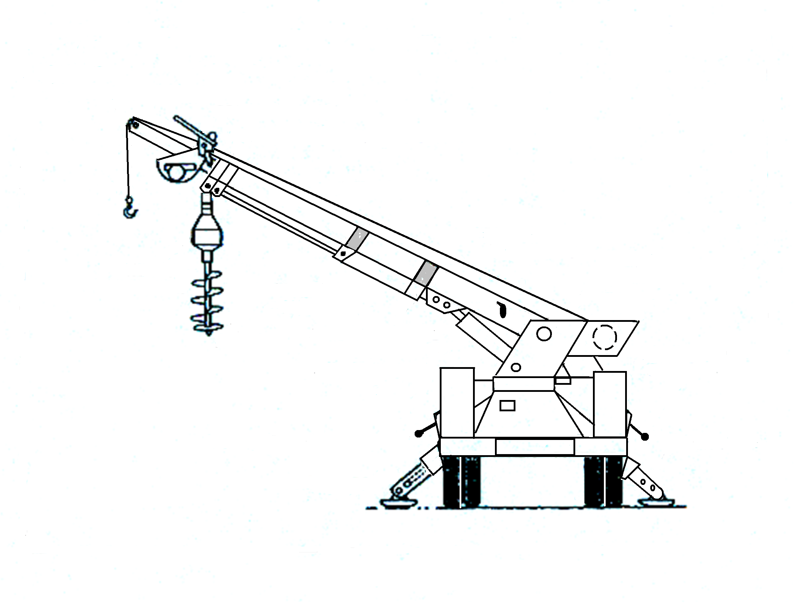
Parts of the Digger Derrick

Slide 9
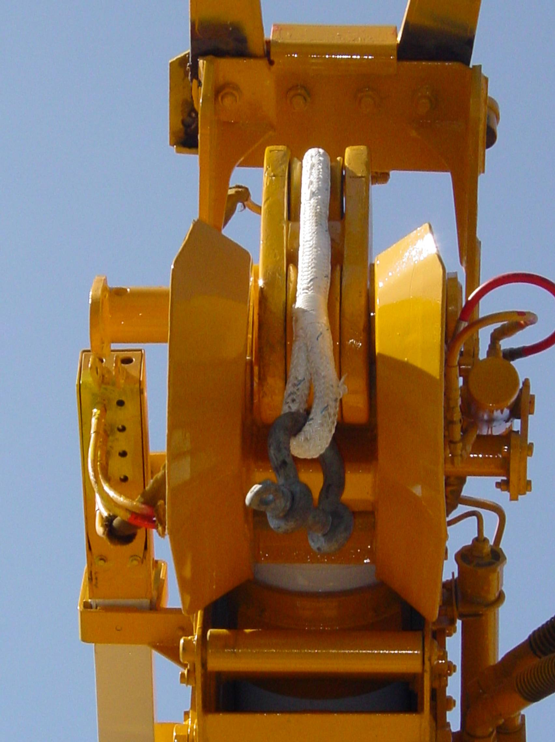
Parts of the Digger Derrick
Boom Tip Sheave
Notes:
The sheave in a digger derrick upper boom tip containing only one sheave, which carries the winch line as it travels from the winch to the load.
The lower sheave in a digger derrick upper boom tip containing two sheaves, which carries the winch line as it travels from the upper sheave (boom tip idler sheave) to the load.

Slide 10
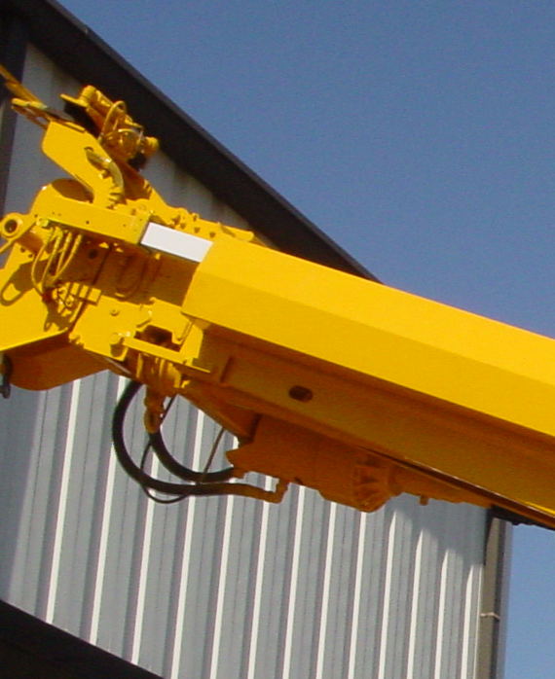
Parts of the Digger Derrick
Upper Boom
Notes:
Boom section in a boom assembly which is farthest from the turntable when the boom assembly is fully extended or unfolded, and which supports the boom tip sheave and/or platforms)

Slide 11
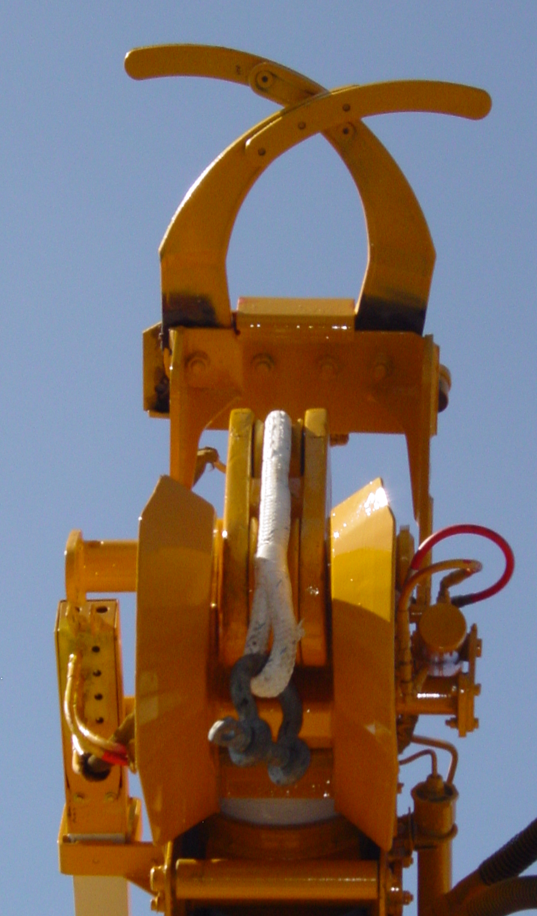
Parts of the Digger Derrick
Pole Grabbers
Notes:
A mechanism at the tip of a boom used for guiding and stabilizing a utility pole while using the winch line to raise or lower the pole

Slide 12
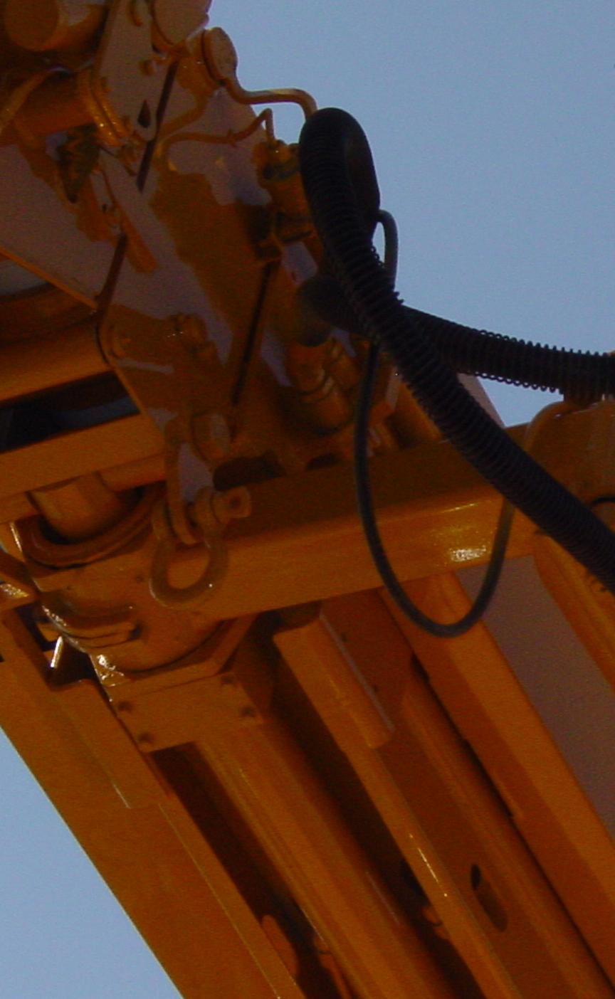
Parts of the Digger Derrick
Digger Hanger Bracket
Notes:
The structural member on a digger derrick which supports the digger link on the extendible boom

Slide 13
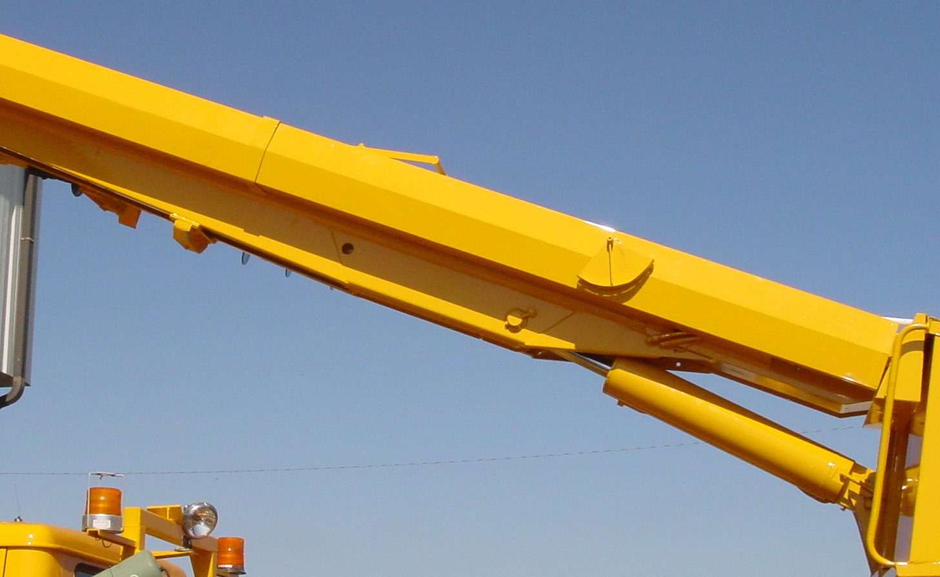
Parts of the Digger Derrick
Lower Boom
Notes:
The boom section in a boom assembly which is attached to the turntable or riser, and which supports the upper boom or intermediate boom

Slide 14
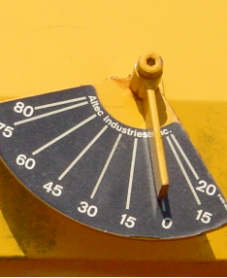
Parts of the Digger Derrick
Boom Angle Indicator
Notes:
A device which indicates the angle between the boom centerline and a horizontal plane

Slide 15
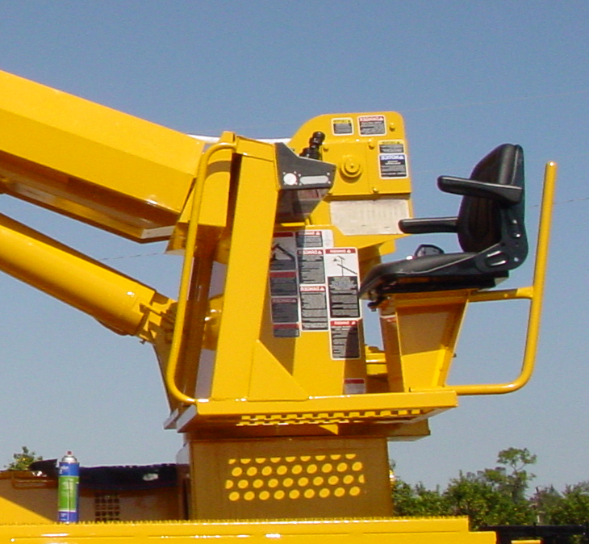
Parts of the Digger Derrick
Turntable Pedestal Assembly
Notes:
The structure located above the rotation bearing which supports the lower boom or articulating arm and rotates about the centerline of rotation

Slide 16
Parts of the Digger Derrick
Winch
Notes:
A mechanism consisting of a gearbox with a cylindrical rotating drum on which to coil a line for load hoisting or line tensioning

Slide 17
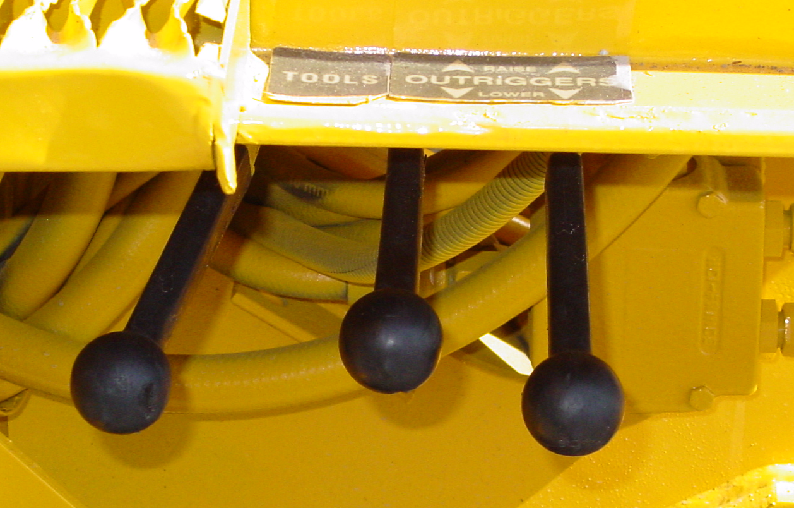
Parts of the Digger Derrick
Outrigger Controls
Notes:
The controls for operating the outriggers
Location may vary from back to sides

Slide 18
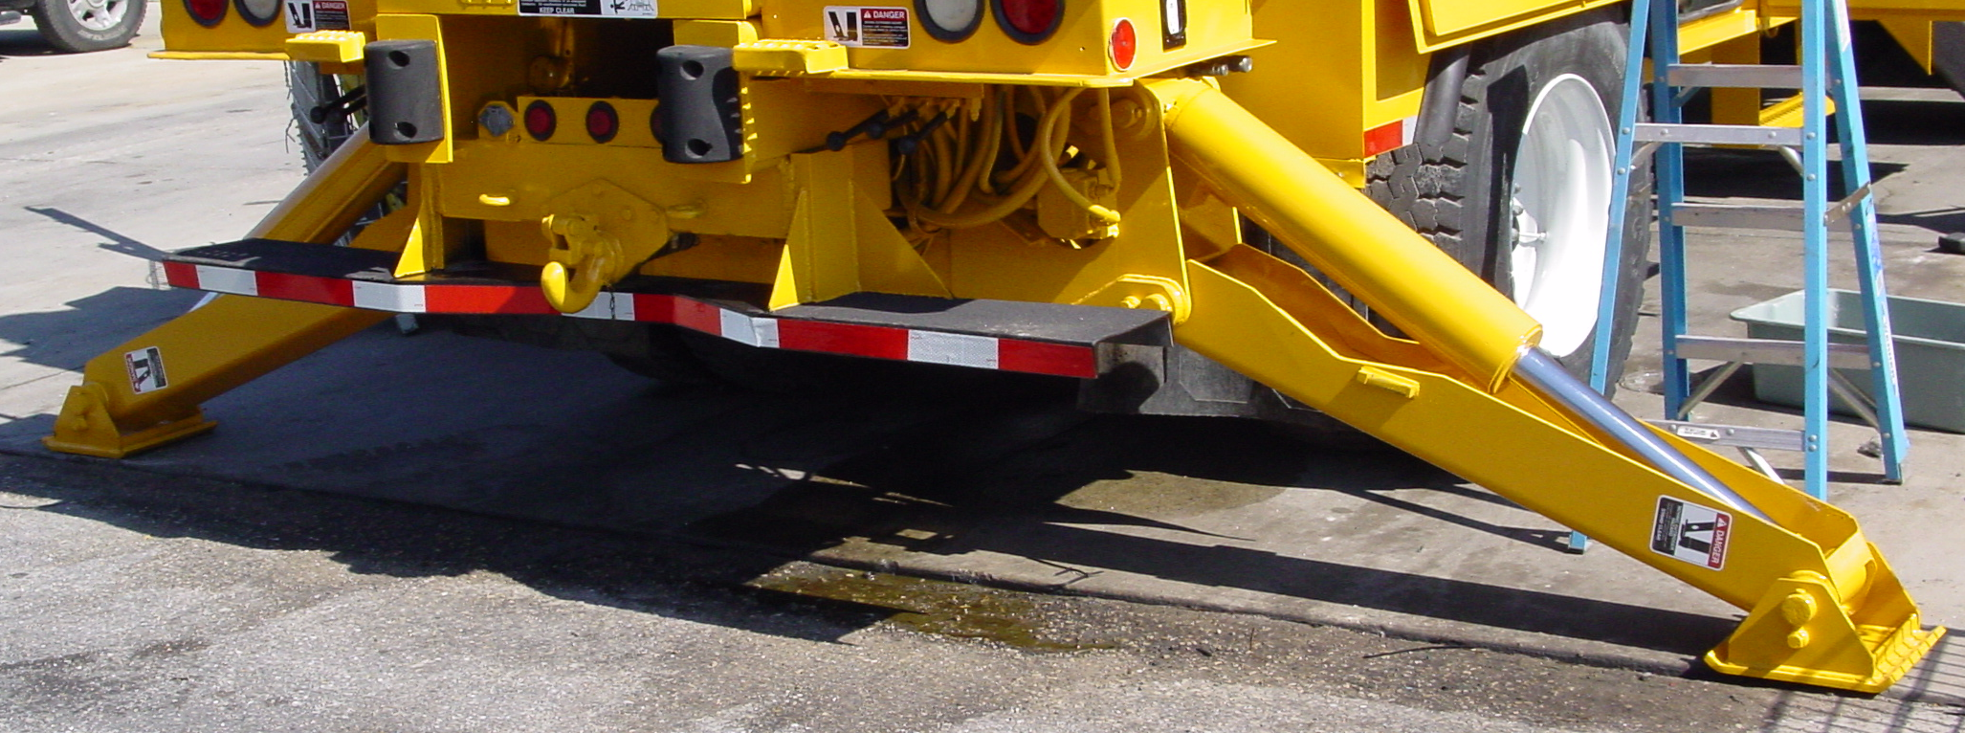
Parts of the Digger Derrick
Outriggers
Notes:
A structural member, which when properly extended or deployed on firm ground or outrigger pads, assists in stabilizing the mobile unit

Slide 19
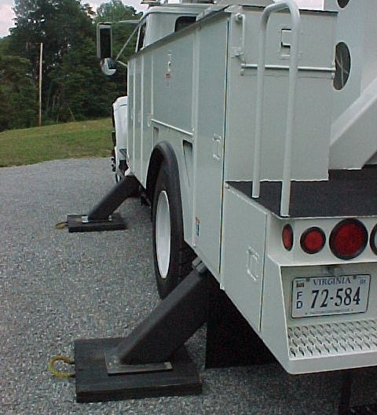
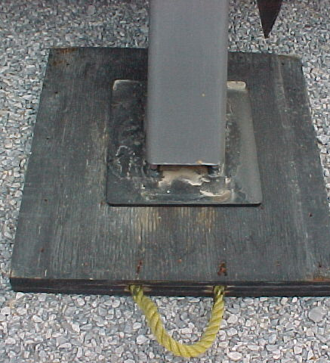
Outrigger Pads

Slide 20
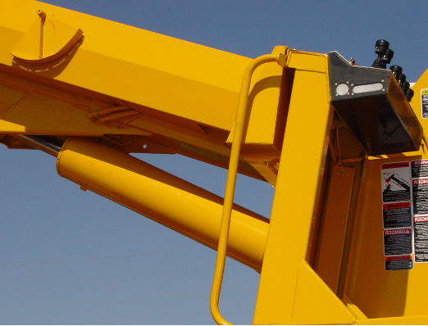
Parts of the Digger Derrick
Boom Lift Cylinder
Notes:
Pneumatic cylinder responsible for the up and down movement of the boom

Slide 21
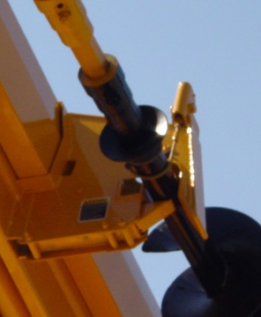
Parts of the Digger Derrick
Auger Stow Bracket
Notes:
Bracket on a digger derrick lower boom which stores the digger and auger assembly when not in use

Slide 22
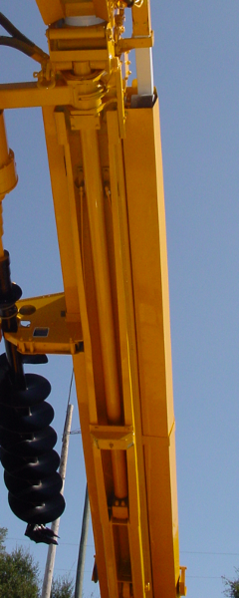
Parts of the Digger Derrick
Boom Extension Cylinder
Notes:
Cylinder connected to the operating controls that retracts or lengthens the boom

Slide 23
Parts of the Digger Derrick
Auger
Notes:
Hole boring tool of the digger, consisting of a hollow tube with hardened teeth attached at one end to dig into and break up soil as the auger is rotated

Slide 24
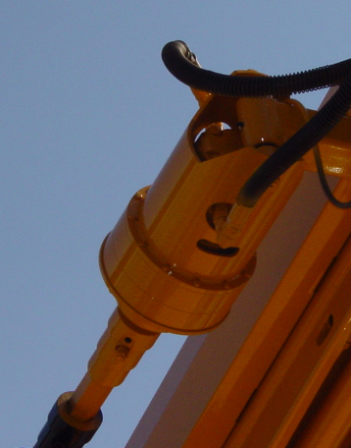
Parts of the Digger Derrick
Digger Mechanism
Notes:
Device which drives the auger

Slide 25
Inspection
Inspection and Maintenance
Aerial devices shall be inspected by the assigned operator daily, before operating, according to the inspections called for in the Instruction Manual issued by the Manufacturer. Special attention should be given to the following:
Inspect hydraulic hoses and remote controls for twisting, chafing and proper adjustment.
With oil lines under pressure, inspect all hydraulic fittings, pumps, cylinders and check valves for evidence of leakage.
Check oil level of hydraulic and remote-control reservoirs. Oil should be added as needed.
Check unit for proper operating speed and rate of drift. Drifting or improper speed should be controlled immediately.
Check operation of all controls through their maximum working range.
Check boom and leveling wire rope cable for frayed strands, security of terminals and correct adjustment.
Check booms for cracked welds or distorted members.
Aerial basket and liners should bear a test date of not over six months old.
Check electrical for all types of deteriorations.
Regulatory Procedures: OSHA 1910.181(d)(1) Inspection classifications, 1926.550(a)(5), ANSI-A 10.31

Slide 26
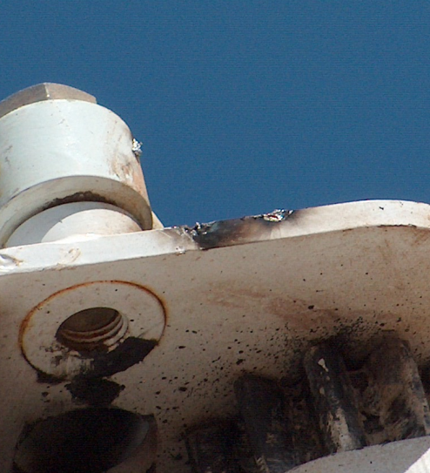
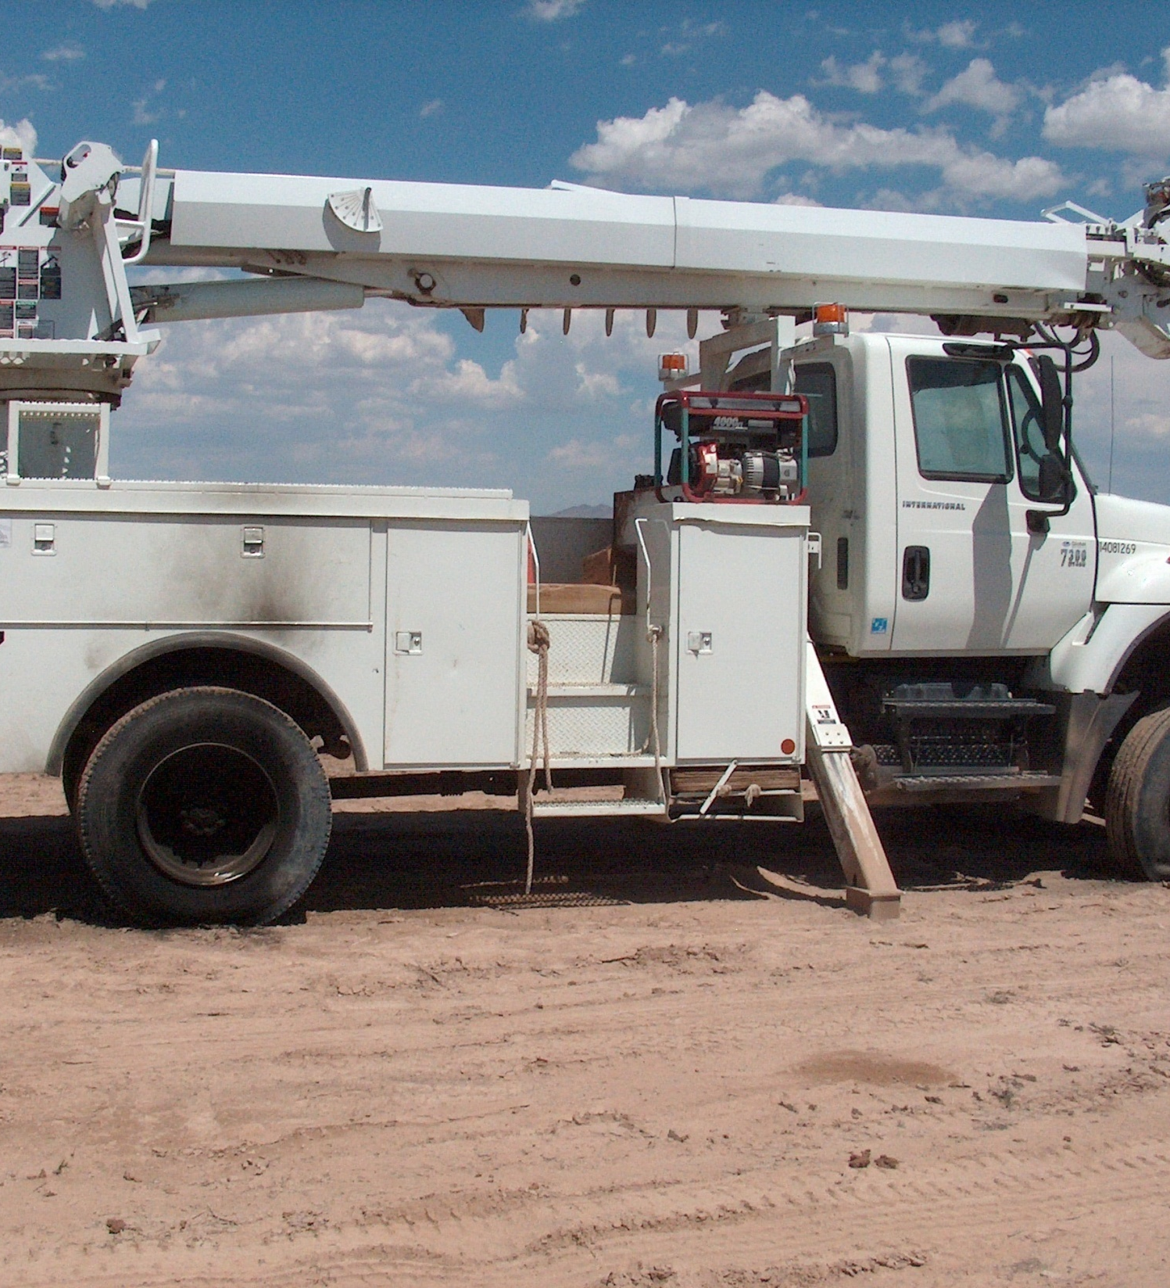
Warning
Do not stick the boom into an energized line

Slide 27
Hand Signals
Standard hand signals developed by ANSI for the U.S. Army Corp of Engineers
The following hand signals are demonstrated by Mr. Lee Minear of Peace River Electric Cooperative, Inc.
Ref: ANSI/ASME B30.6

Slide 28
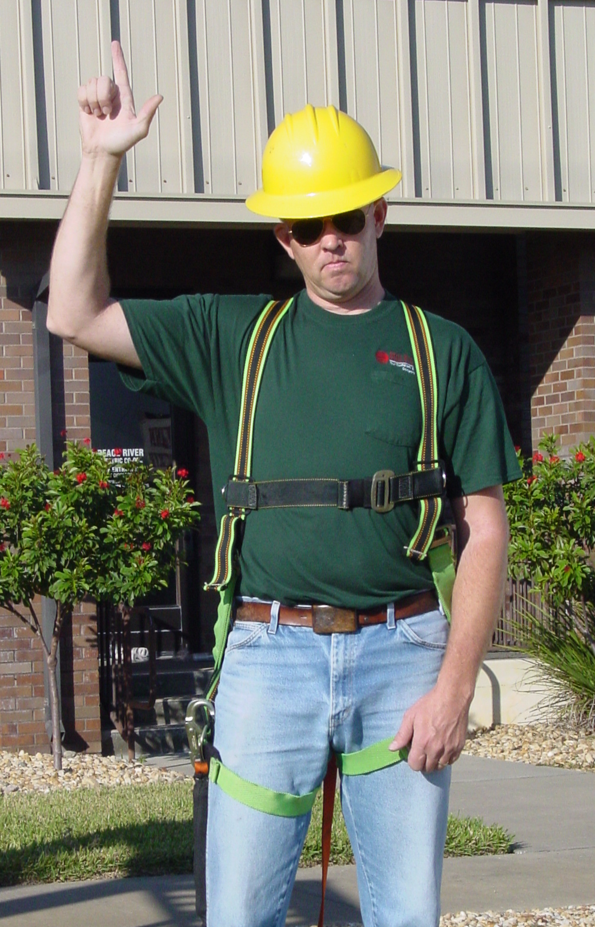
Hand Signals
Raise (Hoist) Load
With forearm vertical, forefinger pointing up, move hand in small horizontal circles

Slide 29
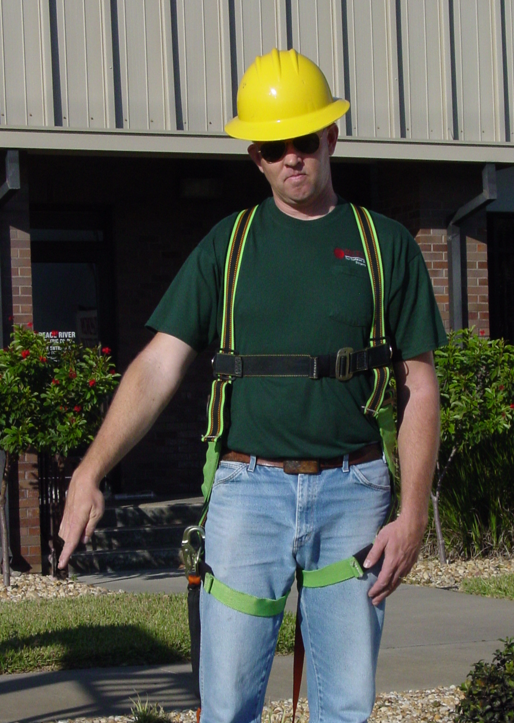
Hand Signals
Lower Load
Extend arm downward, point forefinger down, move hand in small horizontal circles

Slide 30
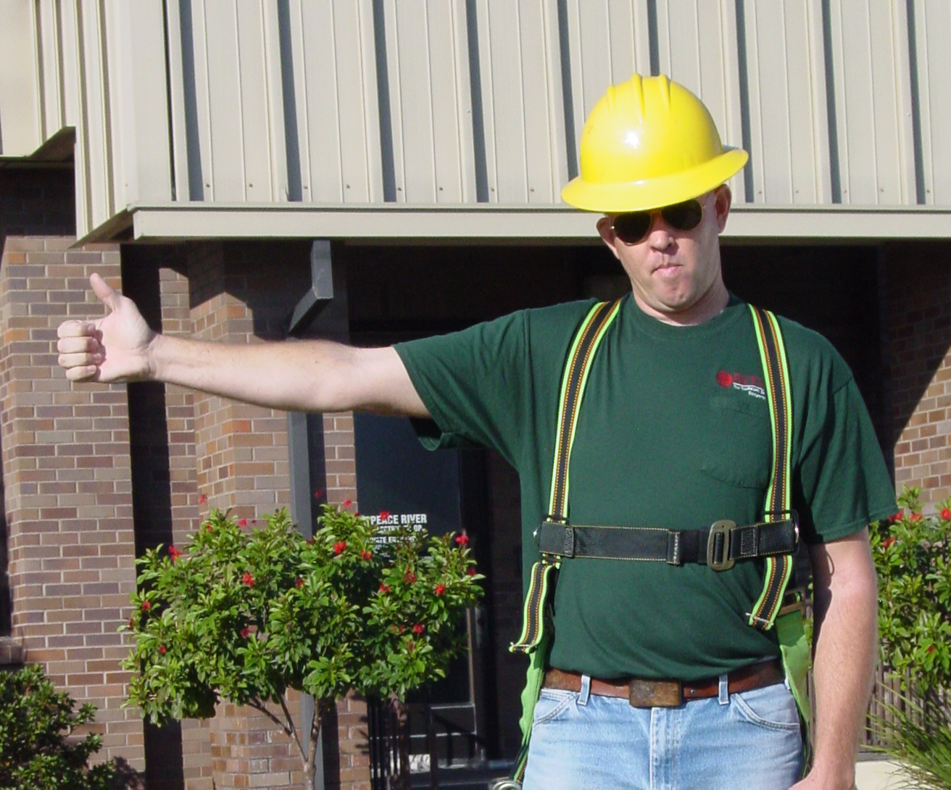
Hand Signals
Raise Boom
Extend arm, close fingers, and point thumb upward

Slide 31
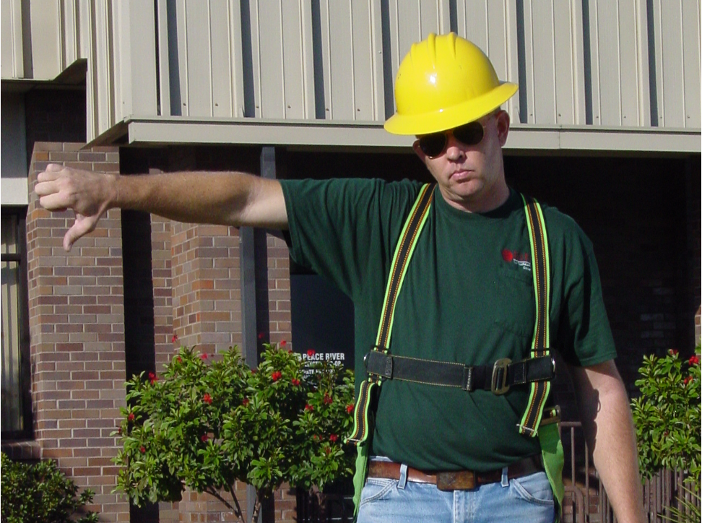
Hand Signals
Lower Boom
Extend arm, close fingers, and point thumb downward

Slide 32
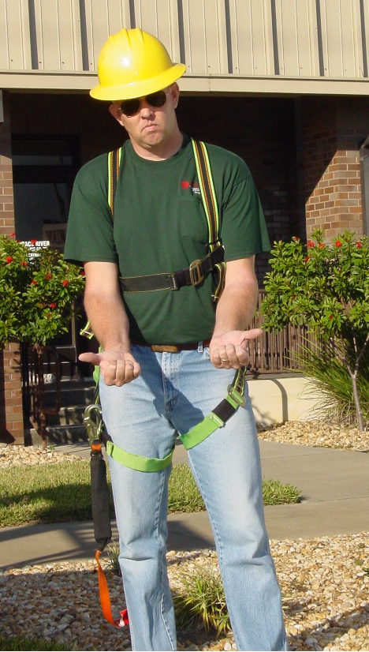
Hand Signals
Extend the Boom
Both fists in front of body with thumbs pointing outward

Slide 33
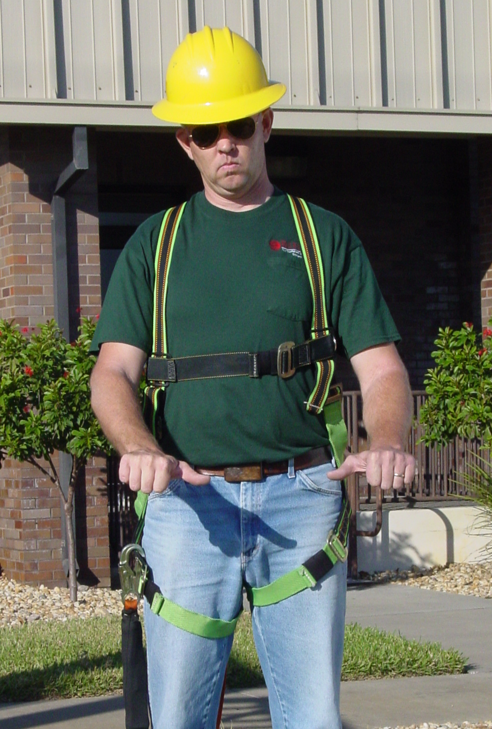
Hand Signals
Retract the Boom
Both fists in front of body with thumbs pointing toward each other

Slide 34
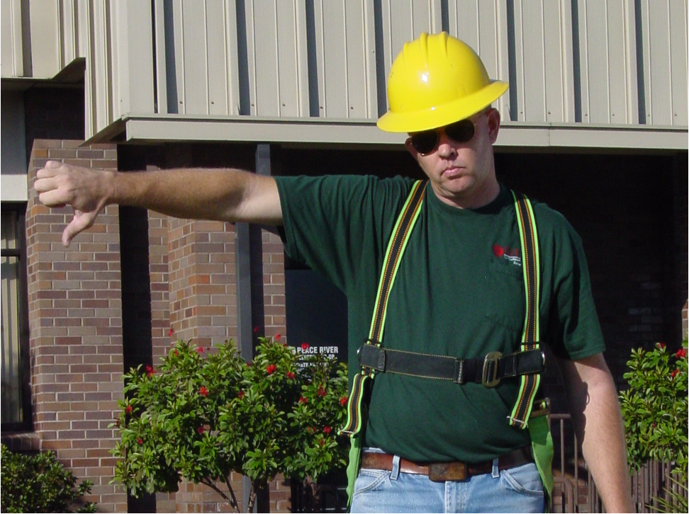
Hand Signals
Lower Boom/ Raise Load
With right arm extended, thumb pointing down, flex fingers in and out, as long as load movement is desired

Slide 35
Hand Signals
Raise Boom/ Lower Load
With right arm extended, thumb pointing up, flex fingers in and out, as long as load movement is desired

Slide 36
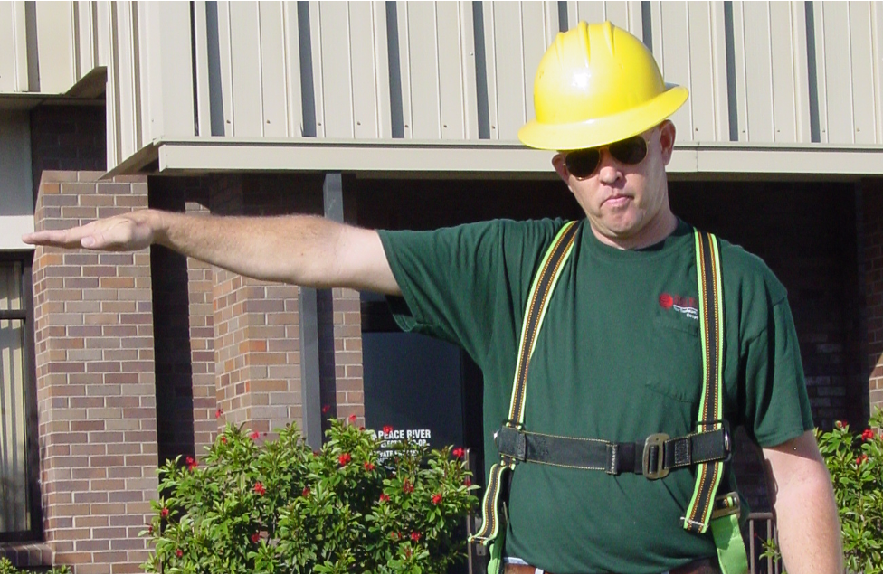
Hand Signals
Swing Boom
With right arm extended, point with finger in direction of boom swing

Slide 37
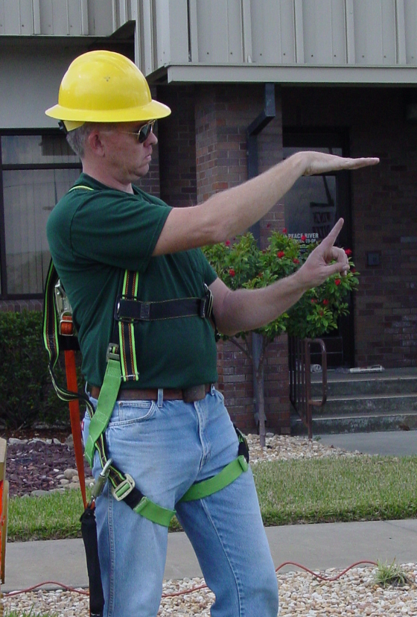
Hand Signals
Move Slowly
Use one hand to give desired motion signal and place the other hand motionless in front of hand giving the motion signal
Hoist slowly is shown here

Slide 38
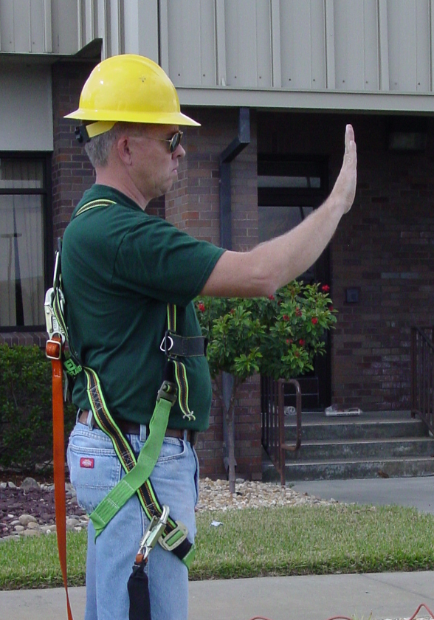
Hand Signals
Travel
Use one hand to give desired motion signal, with palm facing direction of travel

Slide 39
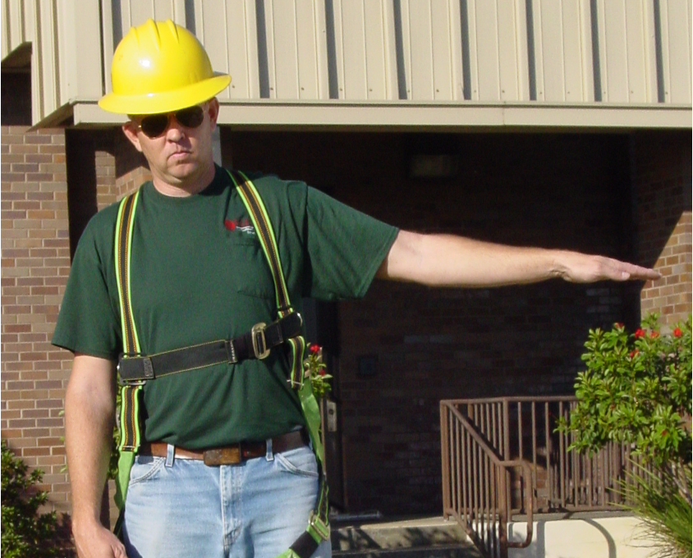
Hand Signals
Stop
With arm extended, palm down, move arm back and forth

Slide 40
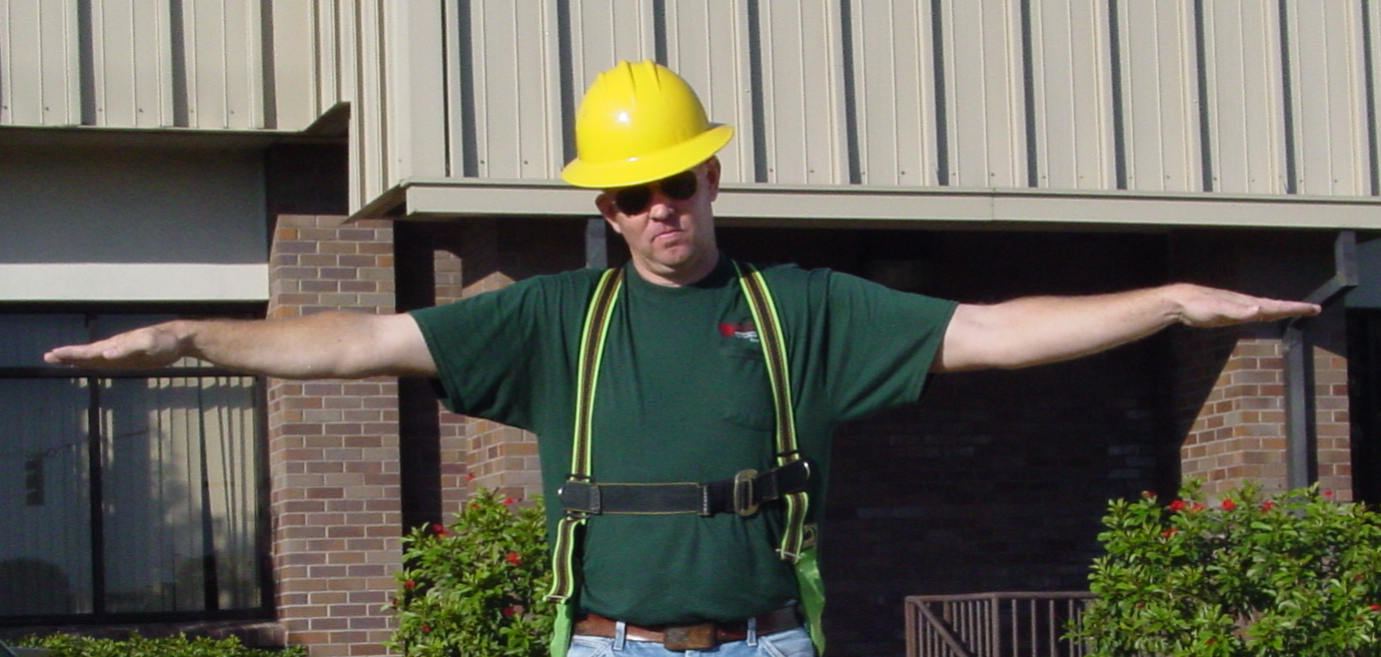
Hand Signals
Emergency Stop
With both arms extended, palms down, move arms back and forth

Slide 41
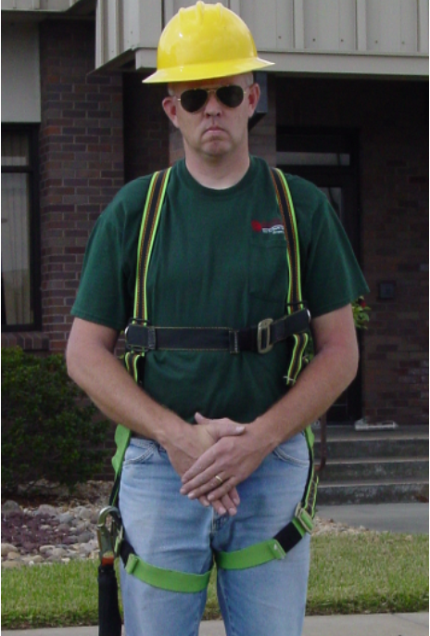
Hand Signals
Hold (Dog) Everything
Clasp hands in front of body

Slide 42
Job Safety Analysis
JOB SAFETY ANALYSIS TRAINING GUIDE
JOB: Basic Digger Derrick Operation Date: __________
Analysis by: ____________________
REQUIRED/RECOMMENDED PPE: Hard hat, safety glasses, work gloves
Reviewed by: ____________________
Approved by: ____________________

Slide 43
Job Safety Analysis
SEQUENCE OF BASIC JOB STEPS
Put on proper PPE: hard hat, safety glasses, work gloves
Review maintenance record
Inspect major parts of the derrick involved in performing each function
Verify the entire digger assembly is stowed properly on the auger stowage bracket
Designate work area
Position truck
Engage PTO, lower outriggers

Slide 44
Job Safety Analysis
POTENTIAL ACCIDENTS OR HAZARDS
Equipment not properly guarded
Unauthorized repairs that could cause problems
Pinch points
Worn parts
Leaking fluid
Malfunctioning booms and derrick
Unsafe equipment
Equipment not working correctly, could cause an accident
Does not meet standard
Guards removed
Improper fuel stored
Uneven surfaces limiting lifting ability
Poor visibility
Poor work surface

Slide 45
Job Safety Analysis
RECOMMENDED SAFE JOB PROCEDURE
Properly trained operators
Daily check
Daily reports turned in; Follow up on reports, to see they are connected
Repair equipment when needed
Set-up truck on as level a surface as possible
Position truck in such a way that hole can be dug off back of truck and truck does not have to be repositioned
Set outriggers on wood or metal blocks
Report any problems or malfunctions immediately

Slide 46
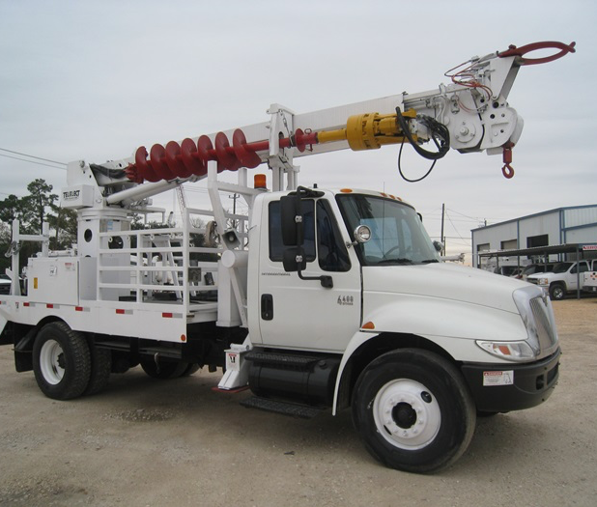
Questions?

Slide 47
Thank you
ISPC
info@ispconline.com
430.201.3201

